Slide 1
Environmental improvement through product development
Introduction

Slide 2
About this material
This approach to environmental product improvement is one of the results of a project funded by the Danish Environmental Protection Agency and conducted in collaboration with the Confederation of Danish Industry (DI), IPU and the Technical University of Denmark (DTU).
The material is primarily aimed at product developers, as a help to building environmental thinking into the product development process - and thus into products.
Authors: Tim McAloone, DTU Management Engineering
Niki Bey, IPU Product Development
Editors: Ulla Ringbæk, Danish Environmental Protection Agency
Bjarne Palstrøm, Confederation of Danish Industry
Kristian Stokbro, Confederation of Danish Industry
Tina Sternest, Confederation of Danish Industry
Case companies: Coloplast A/S
Fritz Hansen A/S
Gabriel A/S
Grundfos Management A/S
LEGO Group A/S

Slide 3
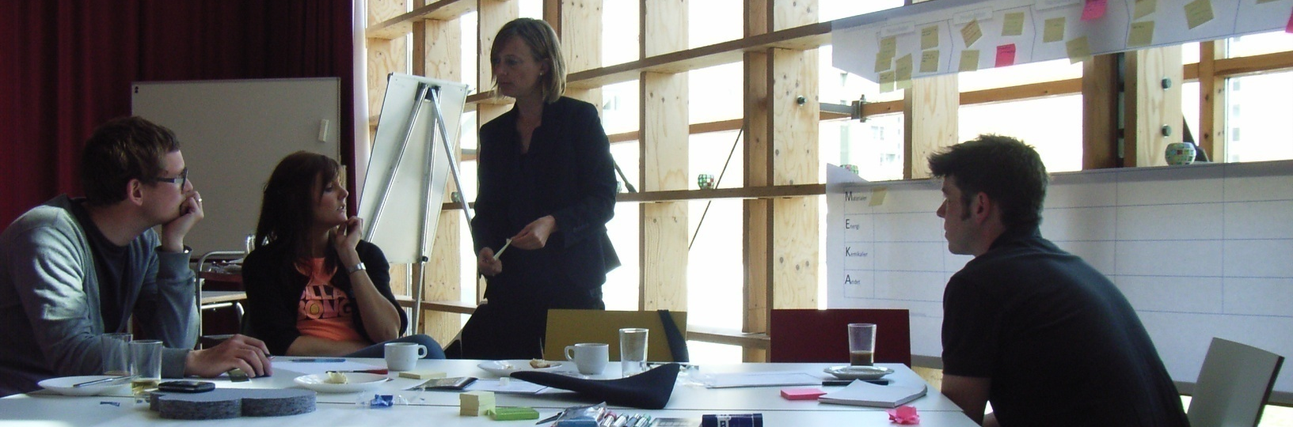
Introduction
Companies in Denmark and abroad are working increasingly to reduce human impacts on the environment and nature. At the same time there must be a sustained focus on the creation of value for customers and consumers. This development gives rise to a huge potential for companies to create new business opportunities, where sustainable development and value creation are integrated early in the design of new products and services.
There is a great opportunity for businesses to create a new and positive agenda, where the focus is on all the good that companies can do for the environment, society and economic growth. Such an agenda must, of course, be based on a high involvement of the competencies of the companies’ own employees, as well as those of partners in the value chain.

Slide 4
Accepting the environmental challenge
Taking a systematic approach to understanding where and why a product has environmental impacts in its lifetime also leads to competitive advantages for the company as processes and relations become transparent.
For instance, around 90% of the waste that can be attributed to many of the products that we meet in our daily lives, has been created before the end-user even gets their hands on the products.
There is therefore a need to create environmentally improved alternatives to existing technologies, materials and procedures.
The company, its customers and its suppliers should all be made aware of the fact, that sustainable development is a collective responsibility, which has consequences for all parties.

Slide 5
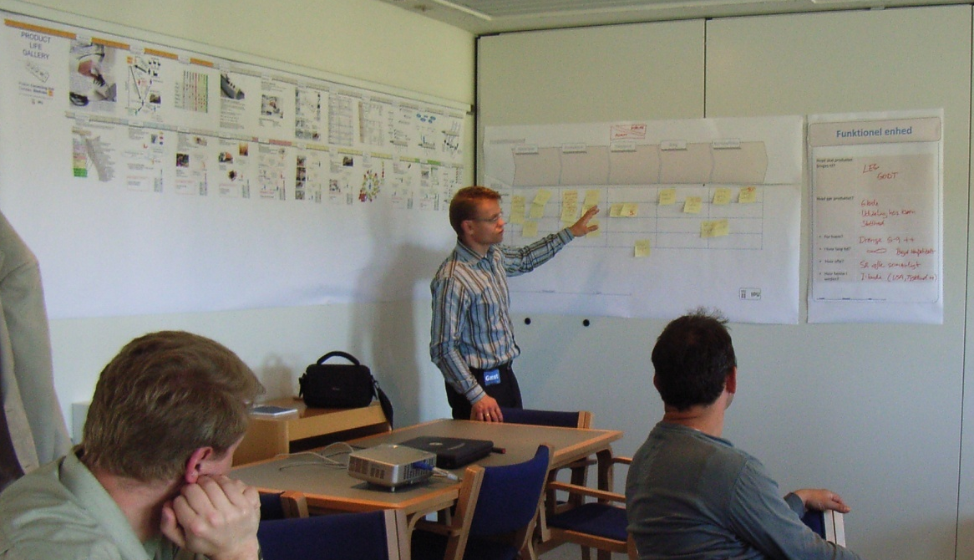
Why think environment into product development?
There are benefits to be reaped from environmental stewardship.
It has been demonstrated, for instance, that environmental thinking in product development leads to efficient products, which are both economically viable to produce, cheaper to operate and maintain, and more robust over their lifetimes.
Systematic environmental thinking in product development leads to products that live up to the demands of legislation and standards, and which customers are increasingly demanding.
By taking a systematic approach to the environmental design task, environmental product improve-ments can often be equated to increased product quality.

Slide 6
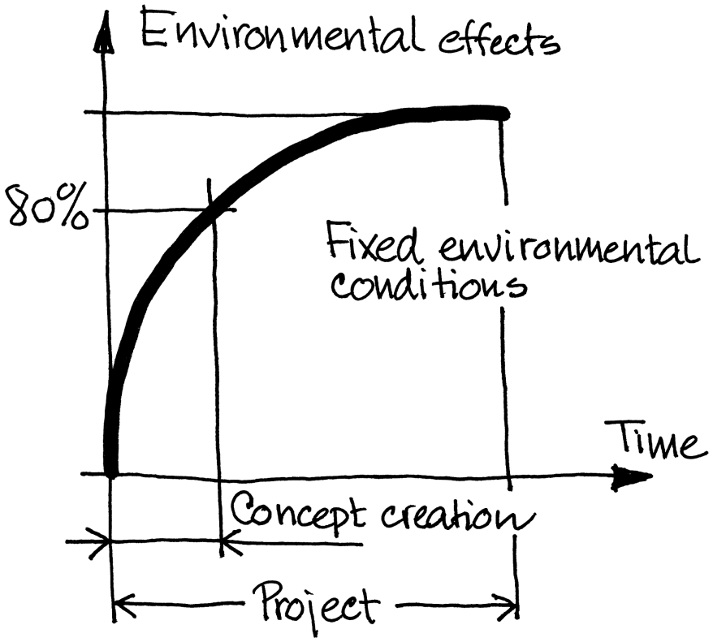
The product developer has the greatest challenge
Environmental impacts are caused in all stages of a product's life, and different products give rise to different types of environmental profiles.
But regardless of the nature, size and time of occurrence of environmental impacts for a product, the vast majority of these have been decided in the early phases of product development.
Approx. 80% of a product's environmental profile is fixed under concept creation in product development
The product developer has therefore a great influence on the product’s life cycle and also on the subsequently occurring environmental impacts.
Approx. 80% of a product's environmental profile is fixed under concept creation in product development

Slide 7
Revealing the product’s life cycle
Good and systematic environmental improvement can only be created on the basis of a solid and deep insight into the product's life cycle.
By forming a picture of the whole life cycle for the product, we can ensure that each stage in the product’s life becomes as environmentally benign as possible.
This activity is called product life thinking.
Product life thinking involves an active and systematic charting of every product life stage, together with the various stakeholders and situations that the product is likely to meet during its lifetime. This broad approach to product development gives the company important insight into life cycle stages such as the product’s use stage, early on in the project.
It is important to visualise the product's life cycle, based on a conception of the various situations and stakeholders that the product will meet throughout its lifetime.
Each product life stage ought to describe both the product and all related activities, in order to create a picture of resource consumption and the root causes of environmental impacts.

Slide 8
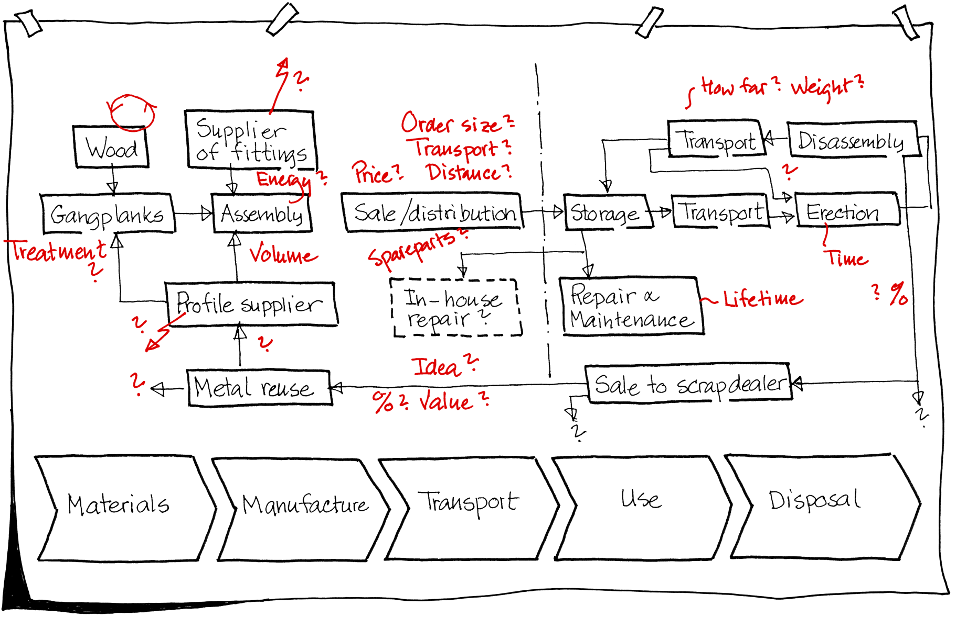
Revealing the product’s life cycle
Example: Mapping the product life cycle for a scaffold. Potential environmental causes are indicated in red.

Slide 9
Environmental improvements in 7 steps
WHY A 7-STEP APPROACH?
Many companies that have had environment on the agenda for some years will righteously be able to claim that they have a good grip on the more eco-analytical tasks and on environmental documentation and reporting. But in contrast, there is often far less focus on the creation of completely new environmental solutions.
The method developed for this approach to environmental improvement in product development will lead you through a 7-step, solution-oriented process, towards environmental improvement.
The 7 steps are simple, inspiring and different from your ordinary product development tasks. The approach creates space for innovation by focusing solely on environmental issues.

Slide 10
Environmental improvements in 7 steps
GET A GRIP ON THE ENVIRONMENT
The following 7-step approach is built up to aid you to:
  get an overview of your product's environmental effects
  provide insight into important details concerning the product’s environmental impacts, its use and its users
  create solutions and concepts that lead to environmental improvements, and
  create foresighted proposals for the creation of an environmental strategy for product development.

Slide 11
Environmental improvements in 7 steps
THE METHOD BEHIND THE APPROACH
The 7-step approach is designed as a chain of exercises that ought to be completed from start to finish. It is important, for example, that the product’s life cycle and environmental impacts are charted, before commencing with the creation of solutions.
The approach requires that a product is chosen in advance, as the object for environmental improvement. The product can be either an already marketed product, which will serve as a reference product, or a product that is currently under development. The first case is the easiest, as it is easier to identify data about the product’s life cycle.
The first 6 steps of the 7-step approach isolate the environmental task and focus on identifying environmental effects. Subsequently improvement proposals are created. Step 7 provides a framework for an action plan and the basis for systematic integration of the proposed environ-mental improvements into the product development process.
* Try in each step to define five key environmental priorities that later can be used to begin a final prioritisation! Mark these priorities with a red ‘*’

Slide 12
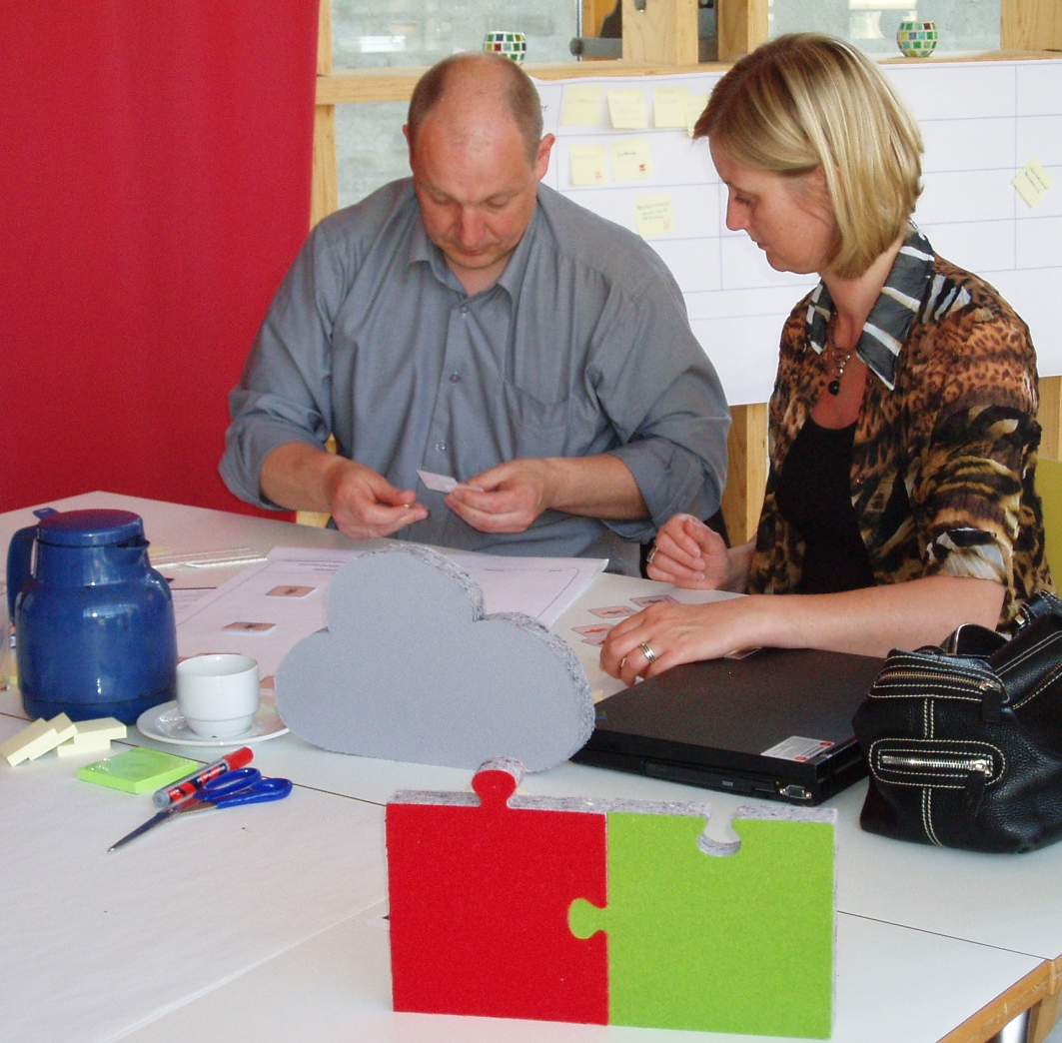
Environmental improvements in 7 steps
WHO SHOULD PARTICIPATE?
The target audience for this approach is all the staff who play an active role in the areas of the company, which may be linked to the product’s environmental impacts.
It is best if the participants represent a wide range of disciplines, from mechanical engineers, through environmental specialists, industrial designers and materials specialists, to the factory manager.

Slide 13
Environmental improvements in 7 steps
PREPARATION FOR THE APPROACH
The approach is executed as a physical meeting, lasting at least one working day. In addition, one should reserve sufficient time for preparation and follow-up work. Active participation from the delegates is a must. Reporting is carried out as a part of the process and environmental improvements are created as the principal outcome.
The following considerations will contribute to a successful workshop:
  Prepare each step carefully beforehand, so the methodology and the necessary practical preparations are ensured.
  Participants should prepare themselves by collecting as much knowledge about the product as possible.
  A coordinator must be identified (either the company’s own environmental champion or an external consultant). The coordinator organises and facilitates the process, as well as motivating the participants to come prepared for meetings.
  At least two examples of the reference product should be provided; one assembled and one disassembled (if the product is suited for this).
  Prepare a working space so as to enable and encourage group discussions – and with plenty of wall space for posters.
  A series of posters should be prepared, to facilitate the process and ensure reporting.
  Create groups of up to 7 people. If there are more than 7 people, then create more groups, which can compete against each other for the good ideas!

Slide 14
Environmental improvements in 7 steps
Step 1
Use context
How is the product used? By whom? For how long? The central issue here is to uncover the environmental impacts related to the product’s functionality for the user.
Step 2
Overview
We expand our view to the life cycle. How is the product manufactured, distributed, and disposed of? Which environmental impacts does this lead to?
Step 3
Eco-profile
The environmental impacts shall be split into four categories so they can be compared. What are the origins of the environmental impacts?
Step 4
Stakeholder-
network
Draw a network of all stakeholders who come into contact with the product. Plot the connections between these, and identify environmental impacts.
Step 5
Put figures on the product’s environmental impacts. Create scenarios for alternative processes, materials and life cycles. Consider the likelihood of the scenarios.
Quantification
Step 6
Try to remove or reduce the environmental impacts by creating solutions towards product- or life cycle changes.
Use the ecodesign principles provided and sketch eco-concepts.
Conceptualisation
Steps 1-6 are an innovative, environmental-oriented experiment. Extract your experiences from these steps and make a generalised plan for your company’s environmental strategy:
Step 7
Make an action plan for the environmental efforts for your company, especially for product development.
Eco-strategy

Slide 15
Environmental improvement through product development
Step 1: Describe the use context

Slide 16
Step 1: Describe the use context
BACKGROUND
As the very first exercise, it is important to reach a common understanding of the product and its value contribution under use. This provides a common starting point for discussions about the environmental improvement possibilities for the product, which you will need later in the process, in order to create product alternatives. It is important that the product alternatives meet the same requirements for the customer. Redundant product attributes should be considered as waste, both from an environmental and a customer perspective.
Step 1 is therefore intended to reach a description of the product's functionality to the user. This description provides the benchmark for all subsequent decisions and can also be used when, for example, alternative concepts shall be compared.
The use context can be described by answering the following questions:
  What should the product be used for?
  What does the product do?
    For whom?
    How long?
    How often?
    Where in the world?

Slide 17
Step 1: Describe the use context
BACKGROUND
“What should the product be used for?” leads to a description of the basic task that the product must carry out for the user.
“What does the product do?” allows for a description of the product's functionality, including the technological principle and the features that the product must possess in order to deliver the service to the user. Sub-functions may, for example, be "to stick to the skin" or "to turn electrical energy into rotary motion".
“... For whom?” leads to a description of the main user or user group.
“... How long?” and “... how often?” lead to a definition of the time frames and use patterns in which the product must operate.
“... Where in the world?” leads to a definition of the geographical area in which the product must operate and probably will be disposed of.
All in all, these responses lead to a clear description of the product in the form of the value contribution that the product delivers to the user.

Slide 18
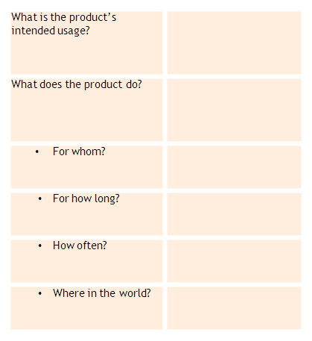
Step 1: Describe the use context
STEP-BY-STEP APPROACH
Write the questions on a large piece of paper.
Answer the questions in your group, based on your knowledge of the product and insight into users' use of the product.
Some of the questions can be answered by looking at the product specification (or the business specification, if the product has not yet been developed).
The exercise is complete when the group has obtained a detailed picture of the product's functions and raison d'être, seen from the user’s viewpoint.
Using this poster (electronic version available) discuss the product and its use context

Slide 19
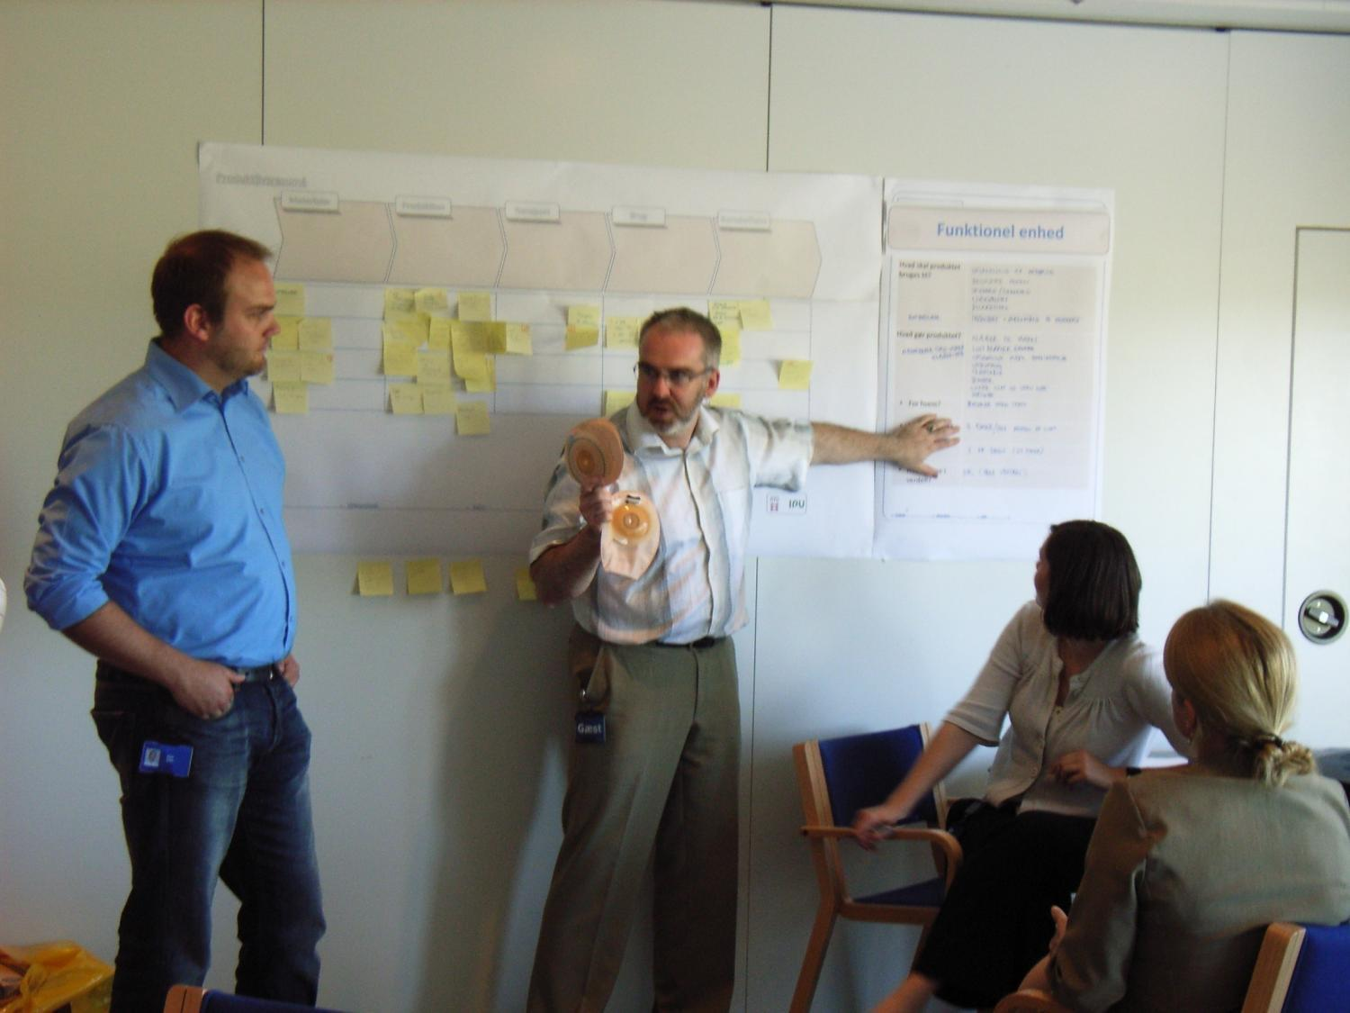
Step 1: Describe the use context

Slide 20
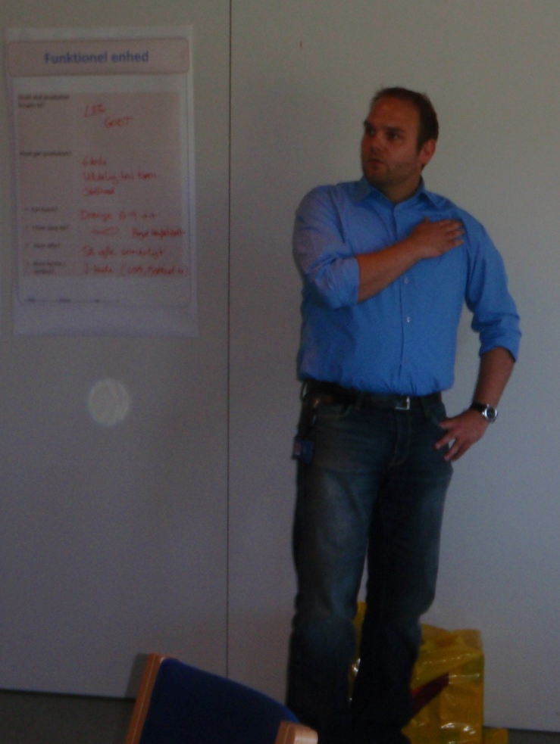
Step 1: Describe the use context
WHY CARRY OUT THIS EXERCISE?
Despite the fact that all group members already have their own understanding of the product, its use and use context, it is beneficial to carry out this initial discussion of the product's use context in order to agree on a common frame of reference.
There are often several versions of the product and various markets (possibly worldwide). It is therefore important in this initial exercise to define a typical product to be used for the rest of the process.
It is crucial that the answers to the six questions in this step form a documented description that the project team agrees upon, and which is sufficiently detailed to allow comparisons with the alternative concepts later on in the process.

Slide 21
Environmental improvement through product development
Step 2: Create an overview of the environmental impacts

Slide 22
Step 2: Overview of the environmental impacts
BACKGROUND
A product life cycle typically consists of five main stages:
  Raw materials covers materials extraction and manufacturing (e.g. plastic granules from crude oil) and semi-finished products (e.g. steel profiles from iron ore), etc.
  Manufacture includes the purchase of components, plus the manufacturing and assembly processes, both at suppliers and in in-house production facilities.
  Transport covers the entire logistics chain, from suppliers to the end-user and beyond, including distribution activities by ships, trains, planes, trucks, vans and cars.
  Use includes the actual usage and possible ancillary products that are necessary for the product to perform its function (e.g. paper filters for a coffee maker). The use stage also includes installation and possible maintenance activities.
  Disposal includes reuse/recycling, incineration and landfill. The actual distribution of these disposal options depends on many factors, including regulatory requirements where the product is disposed of, who disposes of the product (an individual or a company), etc. It is obviously difficult to predict how the product will be disposed of, as this stage is typically far in the future.

Slide 23
Step 2: Overview of the environmental impacts
STEP-BY-STEP APPROACH
Draw five boxes that correspond to the main product life stages on a large piece of paper.
Carry out a brainstorming exercise in which everyone in the group writes all relevant environmental impacts, they can think of. Organise these environmental impacts in relation to the five product life stages.
Write everything you think of, regardless of whether you know that an environmental impact is relevant for the product, or whether you just have an idea about its relevance.
Use post-it notes, as these will be moved around a little later. Write only one environmental impact per post-it note!
The exercise is complete, when the group cannot produce any more ideas.
Tidy the poster by removing any duplicates.
Using this poster (electronic version available) discuss the product and its use context

Slide 24
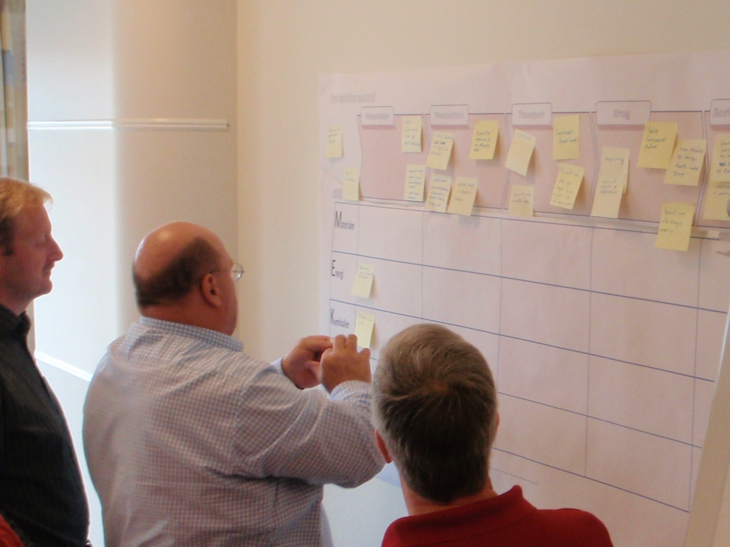
Step 2: Overview of the environmental impacts

Slide 25
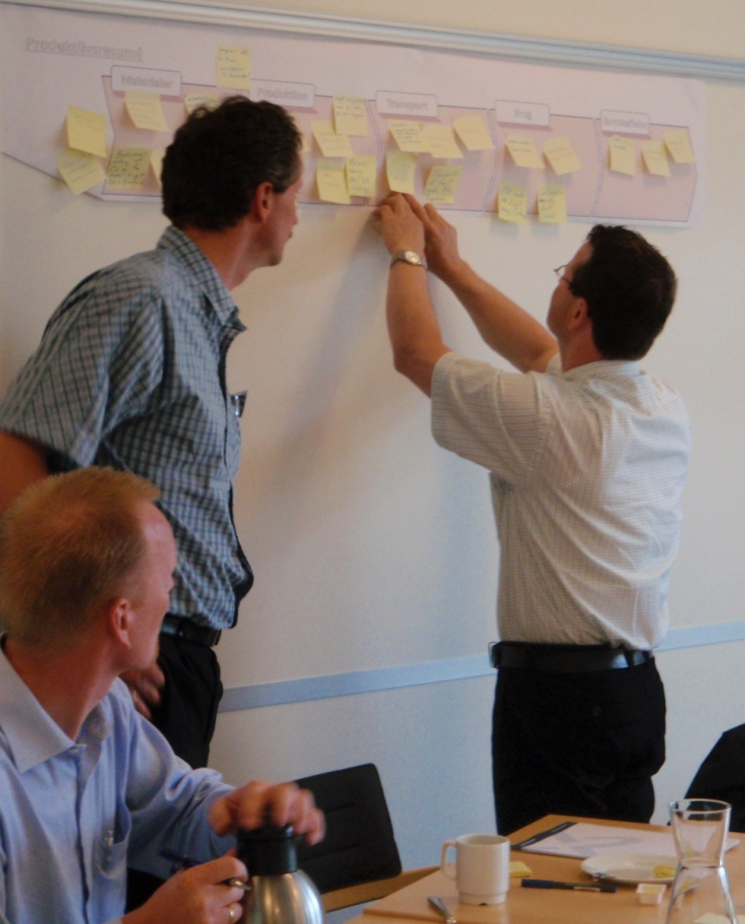
Step 2: Overview of the environmental impacts
WHY CARRY OUT THIS EXERCISE?
This exercise is carried out as a brainstorm, in order to allow everyone in the group to contribute with their own experiences and insights. It will quickly become apparent, that although each individual group member did not have the total overview of all the product’s environmental impacts, the group as a whole could quickly create a fairly complete overview.
When you afterwards look at the product life résumé that has just been created, various patterns can be identified. Maybe one particular product life stage is dominant, as it clearly contains the vast majority of the environmental impacts?
Since the product life résumé shows the environ-mental aspects, distributed over product life stages, it is easy to quickly identify environmental focus areas.

Slide 26
Environmental improvement through product development
Step 3: Create your environmental profile and find root causes

Slide 27
Step 3: Environmental profile and root causes
BACKGROUND
After having created an overview of the product’s main life stages and environmental impacts in Step 2, this step will lead you through an organisation of the environmental impacts, according to their type. Subsequently you will make a note of the possible causes for the environmental impacts’ emergence.
The idea here is to create a more transparent picture of the physical relationships that underpin each environmental focus area. A number of focus areas will then be prioritised, based on your consideration of the need for action.
The already identified environmental impacts will now be organised into one of four categories: Materials, Energy, Chemicals or Other.

Slide 28
Step 3: Environmental profile and root causes
BACKGROUND
Materials: This includes resource and disposal aspects of each life cycle stage, i.e. whether a material is based on a scarce resource, whether it can be easily recycled, or whether it must be landfilled, etc. Remember also to consider whether ancillary materials are used, particularly in the use phase, such as paper filters for coffee makers.
Energy: This includes energy sources and energy aspects in the product life stages. There can, for example, be large differences in energy consumption for material processing, depending on whether one takes new or recycled raw materials into consideration. Remember also to consider component suppliers. The transport and use-related energy consumption is also recorded under this category.
Chemicals: This includes chemical consumption and chemical-related emissions of each life cycle stage, such as toxic chemicals used in manufacture or in the materials.
Other: In this category all other aspects are noted, that one has chosen to consider. For example, health and safety in own (or suppliers’) manufacturing plants, aspects related to Corporate Social Responsibility (CSR), or general economical concerns.
This categorisation of the environmental impacts is created in a so-called MECO-matrix.

Slide 29
Step 3: Environmental profile and root causes
STEP-BY-STEP APPROACH
Draw a MECO-matrix directly under the product life résumé from Step 2. The MECO-matrix should be a 4x5 matrix with space for the post-it notes, which are currently distributed on the product life résumé.
In dialogue with your group, move the post-it notes from the product life résumé, down to the MECO-matrix. Consider each environmental impact in turn, placing them in the most relevant MECO-field.
If an environmental impact covers two or more MECO-fields, copy the post-it note and then place one in each relevant field.
The first part of this exercise is complete when all the post-it notes have been moved down to MECO-matrix.
Materials
Manufacture
Transport
Use
Disposal
Materials
Miljøvenli
For
Mindst
ge
meget
muligt
materiale
vægt
materiale
r
(støbejer
-
indsats
n)
?
  Choose 5 environmental ‘*’ priorities!
Mindre
Reduceret
ressourc
forbrug af
er
Cu og Fe.
Men brug af
Ncl og
Energy
elektronik
Meget
Produktio
energifor
ns
brug
teknologi/
under
energieff
fremstillin
ektiv
g af
P?
-
Energifor
magneter
brug
under
Produktionsfremstilling
produkt
-
Energi
udvikling
Chemicals
(F.eks. støbeproces)
Brug af
giftige
materialer
(ex. bly,
kviksølv)
Other
Using this poster (electronic version available) move the post-it notes down into the MECO categories and then find five * priorities

Slide 30
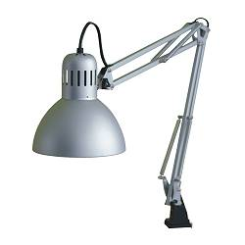

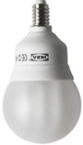
Step 3: Environmental profile and root causes
Example: Comparison of energy-saving bulb with incandescent bulb
Life cycle data:
  Home-use work lamp, 5 years life time
  Comparison:
  Lamp with regular bulbs vs. energy-saving bulbs
  Functional Unit/Service provided: “Provision of light
  (≈ 400 lu) for home workplaces for 5 years (i.e. 10,000 hrs. light) in Denmark”
  Materials
  Lamp, ≈ 1kg: Steel (sheets, springs, tubes, screws), various polymers, copper
  Regular bulb, 60 W, 33g: Glass, nickel-coated tin, cardboard
  Energy-saving bulb, 11 W, 80g: Glass, polymers, electronics (PWB)
  Production: Manufacture and assembly in China
  Transport: 7,200 km transport to Denmark, i.e. 450 kgkm vs. 600 kgkm
  Use: 5 regular bulbs & 300 kWh vs. 1 energy-saving bulb & 55 kWh
  End-of-life: Household waste in Denmark

Slide 31
Step 3: Environmental profile and root causes
MECO (for incandescent bulb)
 | Materials stage | Production stage | Transport stage | Use stage | Disposal stage
Materials | Steel: 750g (net: 700g) Plastics: 200g (net: 170g) Glass: 30g (net: 25g) Cu: 25g (net: 20g) | (very low amounts of ancillary substances) |  |  | In household waste: 1 whole lamp; 5 regular bulbs (5x 33g, mostly glass)
Energy | Steel: 20 MJ Plastics: 16 MJ Glass: 0,3 MJ Cu: 2 MJ In total: ≈ 38 MJ | Incl. overhead Estimated total: ≈ 12 MJ | 450 kgkm 90% ship, 10% truck, i.e. ≈ 0,06 MJ | 300 kWh electricity, i.e. ≈ 2700 MJ | (very low, if at all from plastics incineration)
Chemicals | The List Of Undesirable Substances [LOUS, DK EPA 2004]: flame retardants socket? | The LOUS: E.g. Degreasing agents for painting proc. |  |  | If incinerated, potential dioxin formation from brominated flame retardants
Other | Global material sourcing | Manufacturing in China: E.g. Safe working environment? | Storage & handling in China: E.g. Safe working environment?

Slide 32
Step 3: Environmental profile and root causes
MECO (for energy-saving bulb)
 | Materials stage | Production stage | Transport stage | Use stage | Disposal stage
Materials | Steel: 750g (net: 700g) Plastics: 220g (net: 190g) Glass: 60g (net: 50g) Cu: 25g (net: 20g) | (very low amounts of ancillary substances) |  |  | In household waste: 1 whole lamp; 1 energy-saving bulb (mostly glass, plastics)
Energy | Steel: 20 MJ Plastics: 18 MJ Glass: 0,6 MJ Cu: 2 MJ In total: ≈ 41 MJ | Incl. overhead Estimated total: ≈ 14 MJ | 600 kgkm 90% ship, 10% truck, i.e. ≈ 0,8 MJ | 55 kWh electricity, i.e. ≈ 495 MJ | (very low, if at all from plastics incineration)
Chemicals | The List Of Undesirable Substances [LOUS, DK EPA 2004]: Brominated flame retardants (in plastic socket)? Subst. related to electronics? | The LOUS: E.g. Degreasing agents for painting proc. |  |  | If incinerated, potential dioxin formation from brominated flame retardants
Other | Global material sourcing | Manufacturing in China: E.g. Safe working environment? | Storage & handling in China: E.g. Safe working environment?

Slide 33
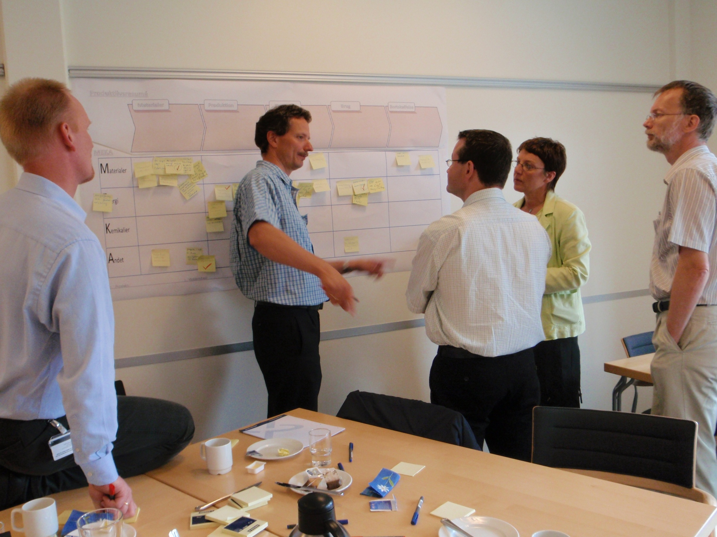
Step 3: Environmental profile and root causes

Slide 34
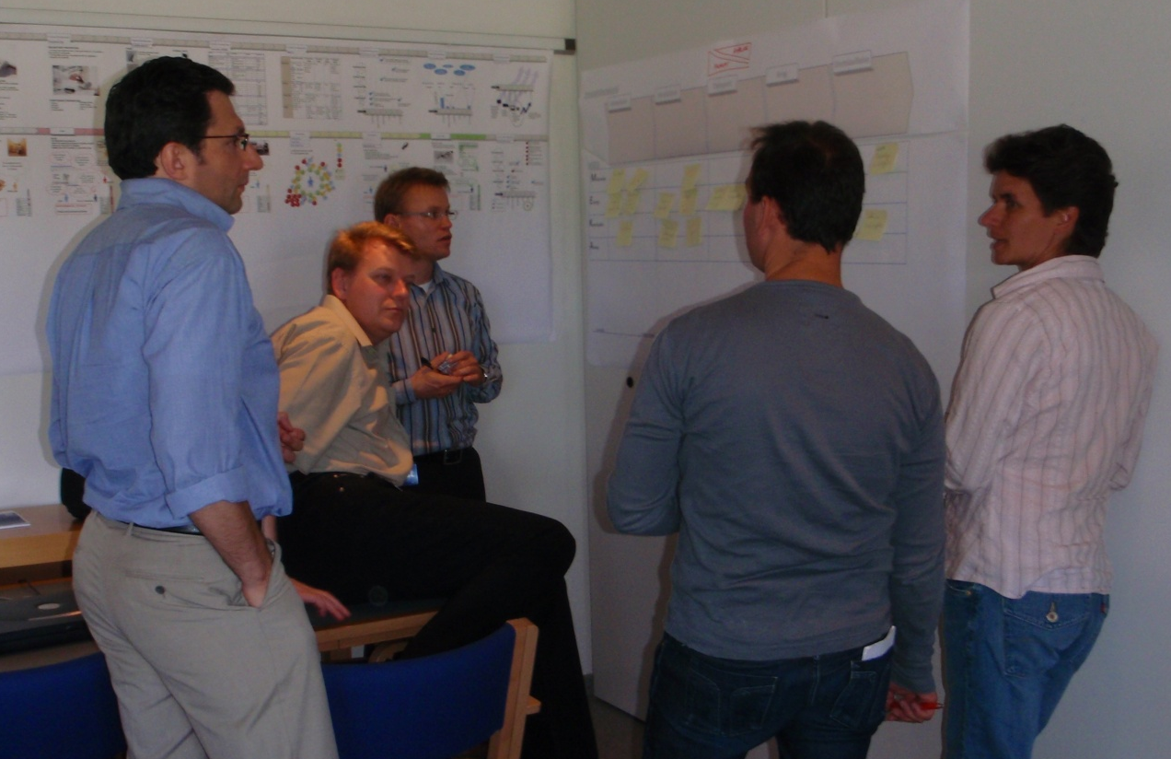
Step 3: Environmental profile and root causes
WHY CARRY OUT THIS EXERCISE?
In principle, you could have started the whole environmental profiling process by filling in the MECO-matrix, i.e. skipping steps 1 and 2. But experience shows that there is a tendency to try to fill the entire MECO-matrix, even though there may not be relevant environmental impacts in every single field of the MECO-matrix.
If the product's use context has not previously been discussed, and if the group has not first had the opportunity to carry out the slightly more unstructured exercise in step 2, confusion can arise with respect to where the environmental impacts actually are in the product.

Slide 35
Environmental improvement through product development
Step 4: Sketch the stakeholder-network

Slide 36
Step 4: Sketch the stakeholder-network
BACKGROUND
Classic environmental efforts in companies take their point of departure in a product or a technology, directing special attention towards the improvement of the product’s life cycle performance.
A weakness of this approach, is that it is built on a large series of assumptions, because there would otherwise be too many uncertainties to be able to make plausible assessment of the product’s environmental ‘goodness’.
It is therefore important to identify the various stakeholders who are connected to a particular set of activities within which the product plays a role.

Slide 37
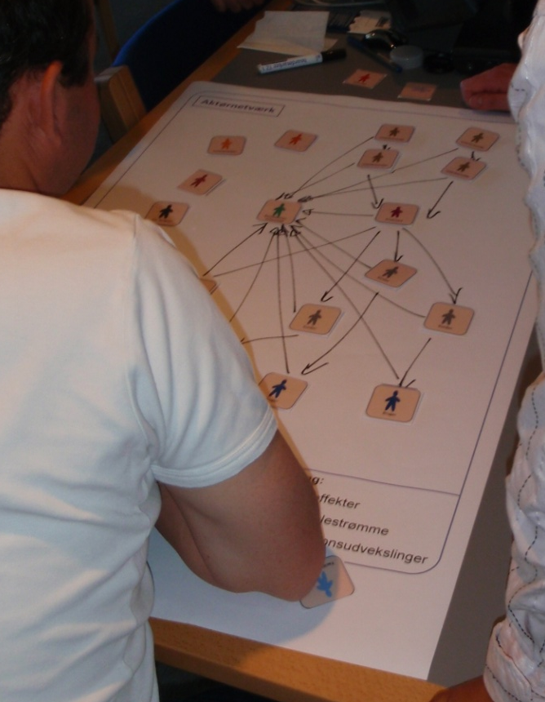
Step 4: Sketch the stakeholder-network
BACKGROUND
Environmental impacts often occur in the exchanges between stakeholders, e.g. in negotiations along the supply chain and/or as a result of lack of overview of the roles and responsibilities in the product’s so-called stakeholder-network.
A stakeholder-network consists of several types of stakeholder, for example, the manufacturing company, a component supplier, an external designer, a freight forwarder, the authorities, customers, users, a disposal company, and so on.
To supplement our understanding of the product's environmental impacts, it is important to sketch the stakeholder-network for the product. Sketching the stakeholder-network gives an insight into which stakeholders influence certain environmental impacts. To clarify the relationship between stakeholders and the impacts that occur, one can outline information exchanges, material flows and the resulting environmental impacts.

Slide 38
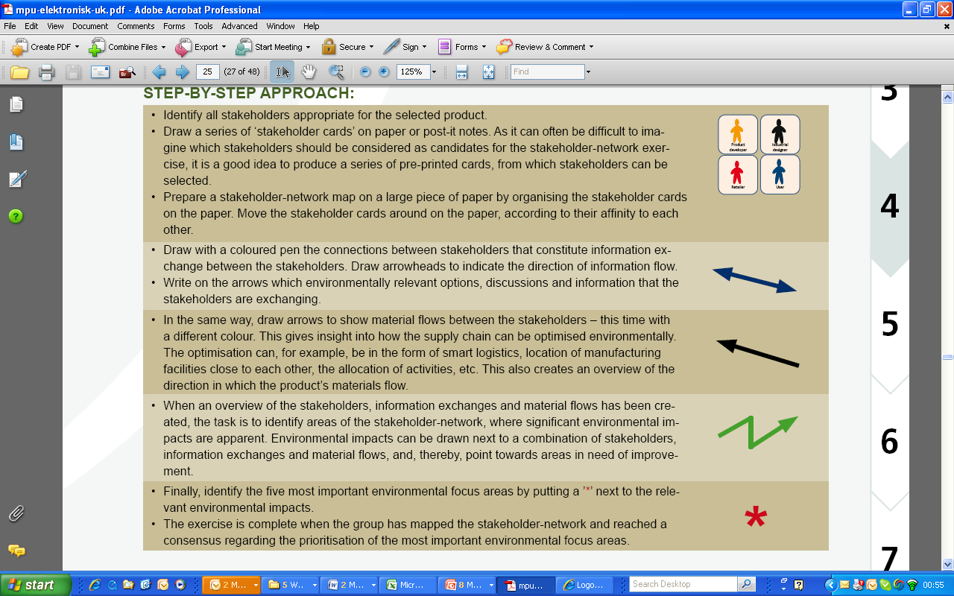
Step 4: Sketch the stakeholder-network
STEP-BY-STEP APPROACH

Slide 39
Step 4: Sketch the stakeholder-network
STEP-BY-STEP APPROACH
  Choose 5 environmental ‘*’ priorities!

Slide 40
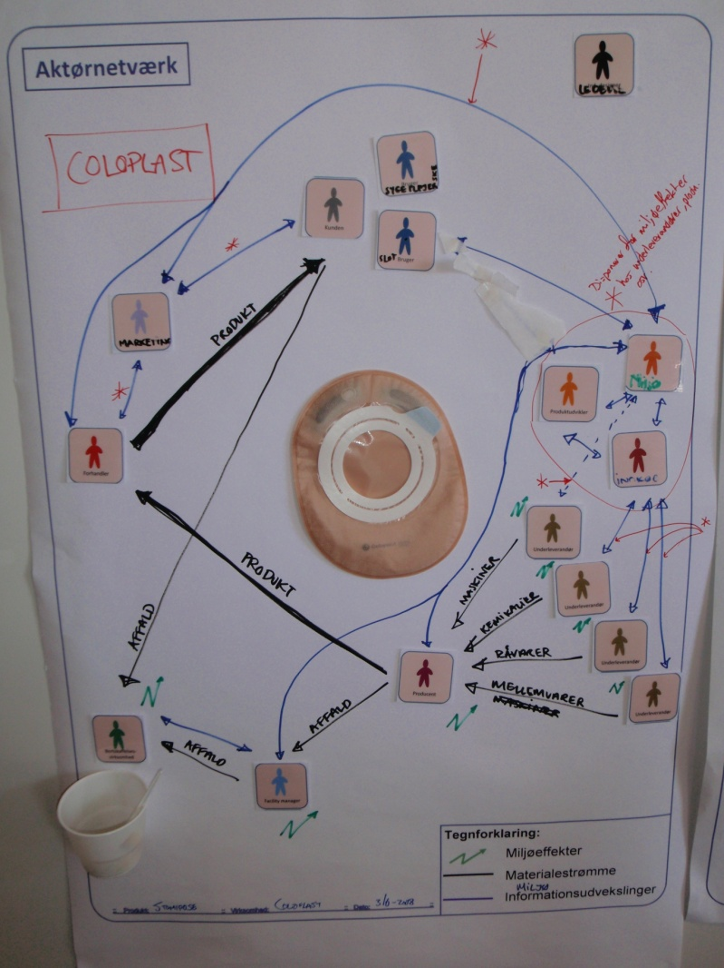
Case example
Identification of environmental impacts through the stakeholder-network exercise at Coloplast A/S
Coloplast places a large emphasis on the environment throughout the product life cycle.
Since Coloplast’s products are medical devices, environmental considerations must share first place with safety and hygiene.
Furthermore Coloplast’s products are not very environmentally burdening in the actual use stage, seen in relation to the rest of the product life cycle.
Coloplast benefitted greatly from the stakeholder-network game, gaining new insights into environmental prioritisation during the development, use and disposal of an ostomy bag.
Example of stakeholder-network at Coloplast, where important environmental impacts have been prioritised, using ‘*’.

Slide 41
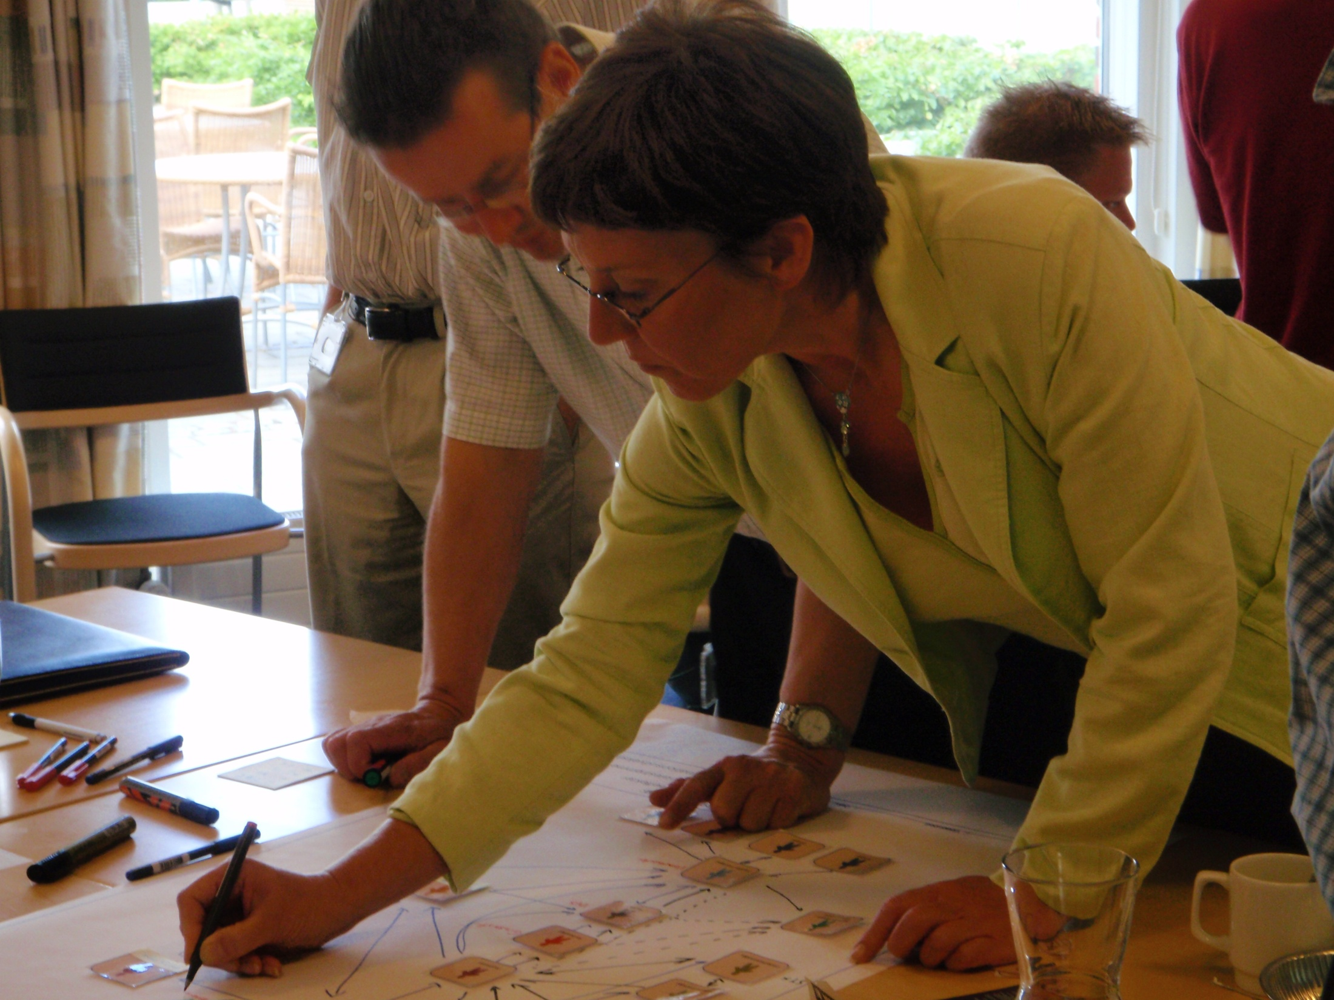
Step 4: Sketch the stakeholder-network

Slide 42
Step 4: Sketch the stakeholder-network
WHY CARRY OUT THIS EXERCISE?
The point of the stakeholder-network exercise is to create an overview of environmental problems’ root causes and improvement potentials.
By creating an overview of which stakeholders are connected to the product throughout its life cycle it becomes apparent, which stakeholders should be considered in connection with environmental improvements – or alternatively, which stakeholders should by no means be involved in the environmental task, thus ensuring relevant and likely environmental improvements.
“The stakeholder-network exercise gave a good overview of the many stakeholders that we are dealing with. The graphical exercise was good for us to identify not only environmental impacts, but also their initiators. The exercise could not, however, have been carried out in isolation; it was a natural consequence of the previous exercises, which were necessary for us to create an overview of the product's actual environmental impacts.”
[Helle Nystrup, Grundfos Management A/S]

Slide 43
Environmental improvement through product development
Step 5: Quantify the environmental impacts

Slide 44
Step 5: Quantify the environmental impacts
BACKGROUND
Many decisions about the product’s environmental profile can be taken on the basis of experience, dialogue and scenario-building. But it is inevitable that some judgments and choices in product development must be based on hard numbers and quantitative assessments.
The fifth step in the 7-step approach is to quantify the environmental impacts, with the help of a quantitative life cycle assessment technique. The figures created in this exercise will be used to carry out an internal comparison of product alternatives and visualisation of the orders of magnitude between the impacts of the product manufacturing processes and materials, activities in the product life cycle stages and alternative life cycles.
SIMPLIFIED METHODS
Life cycle assessment tools are used to quantify the environmental impacts of products and systems. For the busy product developer, there are a number of simplified life cycle tools, such as: “Life Cycle Check” and “Ecodesignguide” from Denmark; the Austrian “Ecodesign PILOT”; the Dutch “Eco-Indicator 99” and “ECO-it”; or the Swedish “EPS”.

Slide 45
Step 5: Quantify the environmental impacts
BACKGROUND
Choice of method depends on:
  who will apply the method (a product developer, an industrial designer or an environmental specialist?)
  how much one knows about the product at the time of the use of the method, and
  whether one wishes to use a computer tool, or whether a pocket calculator would suffice, and so on.
The outcome always depends on three factors:
  the model one uses (for example, the processes one chooses to include in a life cycle phase, and possibly their presentation in a computer tool)
  the data one bases the calculations on (general or specific data, self-collected data or data from literature, older or newer data, etc.)
  the method itself (for example, inherent decisions connected to the procedure).
Common for all methods is that one must define the product life résumé and model this within the framework of the method. Some methods include data on materials and processes, which ease the quantification task, especially if the method is software-based.

Slide 46
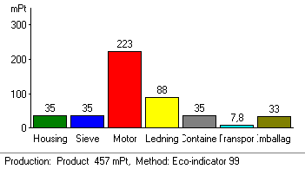
Step 5: Quantify the environmental impacts
FOR INTERNAL USE ONLY!
Be aware that results can vary depending on the combination and content of the three factors: model, data and methodology. And you should not take the result for more than it is – merely a quick and general estimation.
If you wish to use quantified environmental figures in connection with external communication to customers and suppliers (for example, in environmental reporting), you must make full life cycle calculations according to ISO standards and have these reviewed by a third party. Simplified methods are not sufficient for external communication.
However, simplified methods are often both sufficient and the most useful choice for daily product development work – especially after they have been used a few times in the company, to both learn the technique and to tailor the databases and the model.

Slide 47
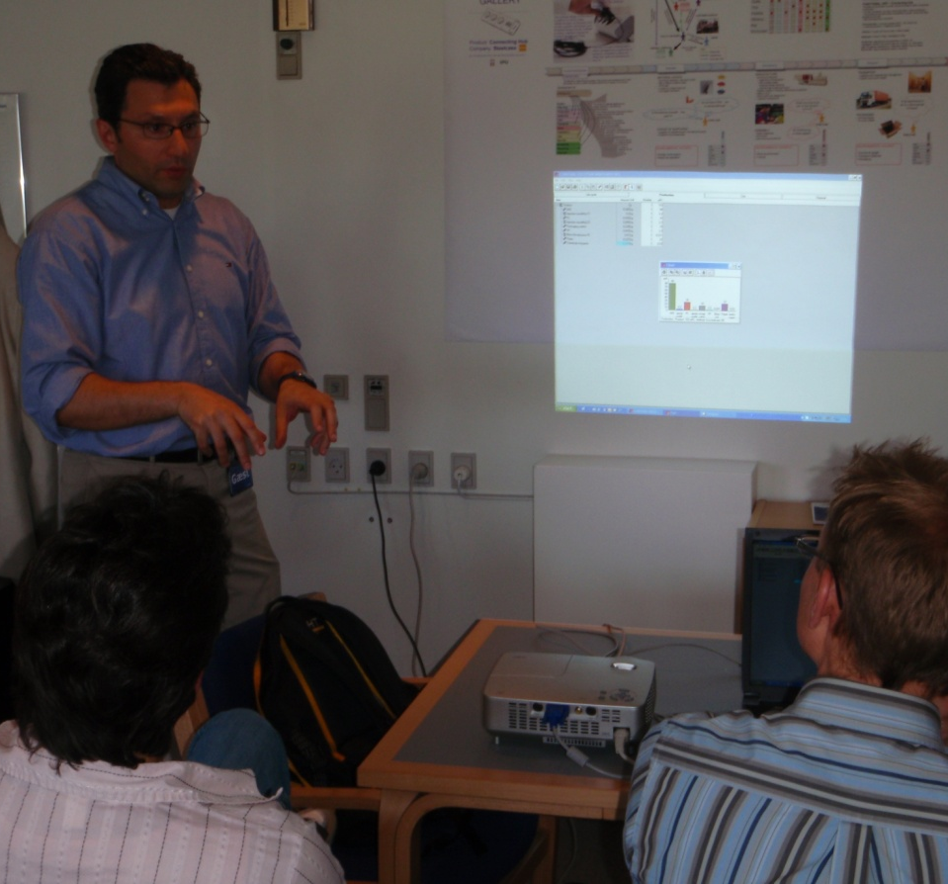
Step 5: Quantify the environmental impacts
STEP-BY-STEP APPROACH
Choose a method for assessing the environmental impacts of your product. Use the results from Step 1 to 4 to describe the product and its life cycle.
Work step-by-step through the method and record underway the different assumptions, you have to make. The method typically requires data on product name, functional unit, materials, manufacturing processes, transport, use scenarios and disposal scenarios.
The exercise is complete when the product's life cycle can be modelled in relation to its environmental impacts, and some environmental focus areas can be identified, which the method has helped to reveal.
Prepare a presentation of the results from the exercise and then identify five environmental focus areas ('*').

Slide 48
Step 5: Quantify the environmental impacts
LCA results are usually complex
Example of an LCA result –
Four product alternatives compared in 5 impact categories

Slide 49
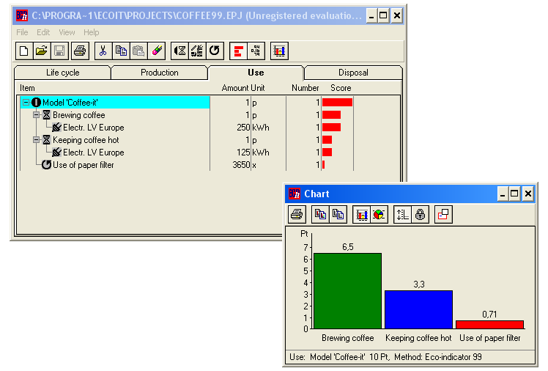

Step 5: Quantify the environmental impacts
Tools for simplified LCAs: e.g. ECO-it
Eco-indicator & ECO-it
[Download fra www.pre.nl]

Slide 50
Step 5: Quantify the environmental impacts
Environmental impact reduced to a single indicator
Eco-indicator & ECO-it
[http://www.pre.nl]

Slide 51
Step 5: Quantify the environmental impacts
Example of using ECO-it
Abridged LCA of a citrus press, using ECO-it

Slide 52
Step 5: Quantify the environmental impacts
Assumptions during the assessment
Materials stage
  What product version is chosen representative?
  Which parts does it consist of? (incl. motor)
  Which types & weights of materials? (gross/net)
Production
  Which processes are involved? (incl. overheads)
Transport stage
  Which distances will be covered?
  With which means of transport?
Use stage
  How often will the citrus press be used (and cleaned)? and where?
End-of-Life/Disposal stage
  What is/are the most likely disposal way/s?

Slide 53
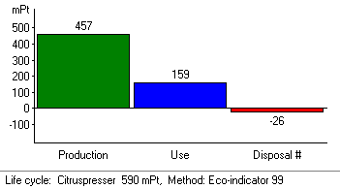
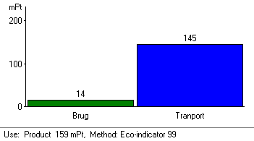
Step 5: Quantify the environmental impacts
Results
ECO-it results in the different life cycle stages

Slide 54
Step 5: Quantify the environmental impacts
Quantify the environmental effects
  Use an abridged LCA tool, such as ECO-it, to model your product’s life cycle
  Choose 5 environmental ‘*’ priorities!

Slide 55
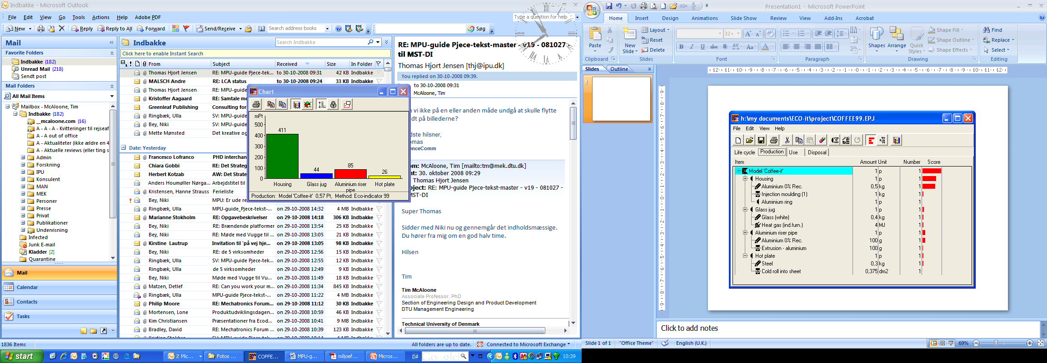
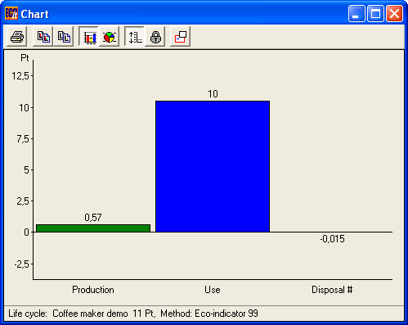
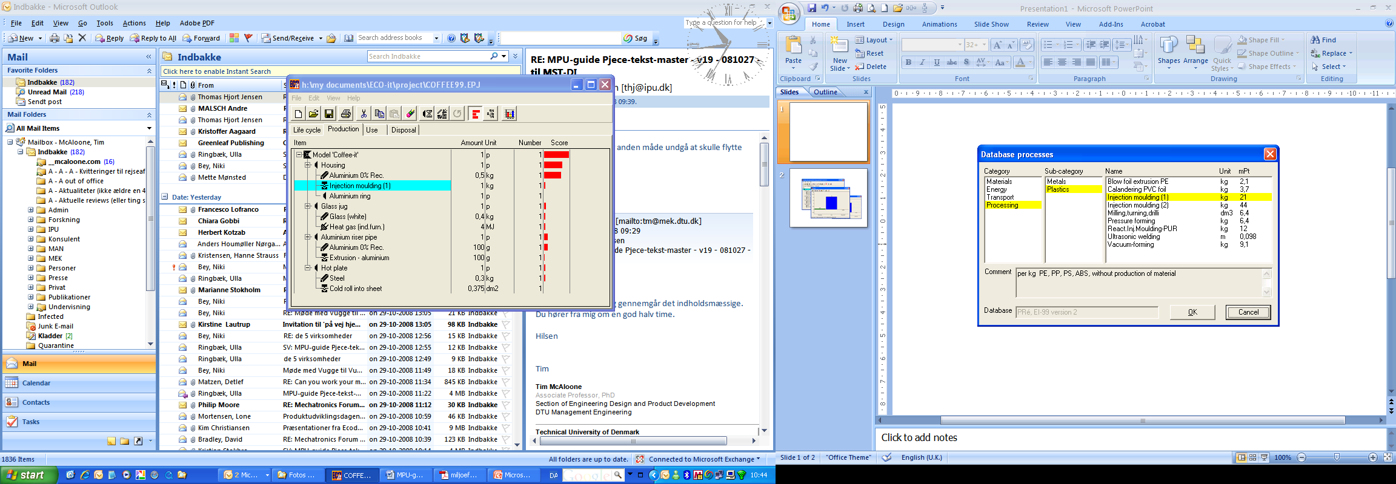
Step 5: Quantify the environmental impacts

Slide 56
Step 5: Quantify the environmental impacts
WHY CARRY OUT THIS EXERCISE?
The quantitative environmental exercise provides another entry point to the environmental improvement task, based on highly simplified assessment methods.
The limitations of these tools are clear; many assumptions must be made and the results are only as reliable as the data and model underlying the calculations. But even with these limitations, these simplified methods give a quick overview of a product's environmental profile.
In addition, you can use the tools to create scenarios where, for example, alternative processes or materials are compared.
The figure shows results from the “ECO-it” tool, which in this example shows that the product’s environmental impact in the use stage is 20 times larger than the manufacturing stage, and even higher than in the disposal stage.

Slide 57
Environmental improvement through product development
Step 6: Create environmental concepts

Slide 58
Step 6: Create environmental concepts
BACKGROUND
In this task you will create solutions for the product and the product's life cycle, which can lead to environmental improvements. Based on the series of environmental insights that you have gained during the previous five steps, it is now time to start creating environmental concepts for the product.
There are various tools available to aid this task:
  Those, which you have always used in product development - brainstorming, brainwriting, sketching, etc.
  There are checklists and negative checklists, which prompt environmental thinking.
  You can create future scenarios (e.g. “Outline the world's least energy-consuming house, which can be realised in the year 2020”) in order to make a leap forward and perhaps find radical environmental concepts.
  The largest help is most likely to be gained by identifying relevant ecodesign principles that can inspire and guide the environmental conceptualisation process.

Slide 59
Step 6: Create environmental concepts
ECODESIGN PRINCIPLES
  Reduce the material intensity of the product or service
  Reduce the energy intensity of the product or service
  Reduce the dispersion of harmful substances through the product
  Increase the amount of recycled and recyclable materials in the product
  Optimise the product’s durability
  Incorporate environmental features into the product
  Signal the product’s environmental features through the physical design
  Maximise the use of sustainable resources and supply chains
  Optimise the product’s service intensity
  Design the life cycle first and then the product

Slide 60
Step 6: Create environmental concepts
Create ideal concepts
CREATE IDEAL CONCEPTS
An ideal concept is a solution proposal, which is exclusively focused on a single optimisation parameter. The aforementioned ecodesign principles can be used to create a number of ideal concepts that, for example, are optimised towards:
  Minimum material content in the product
  Minimum energy use throughout the product's life cycle
  Minimum content of toxic substances
  Optimal reusability
  Optimal durability
  Inbuilt environmental functions in the product
  Clarification of the environmental characteristics of the product
Use an hour on each of the above optimisation proposals (you could also add some of your own) and produce a poster for each concept with brief explanations for specific characteristics, etc. The posters will show how far each ecodesign principle can be stretched for the current product. Good sub-solutions can then be chosen from ideal concepts, in order to construct one or more concrete and realistic environmental product concepts.

Slide 61
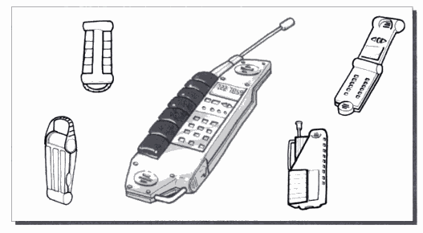
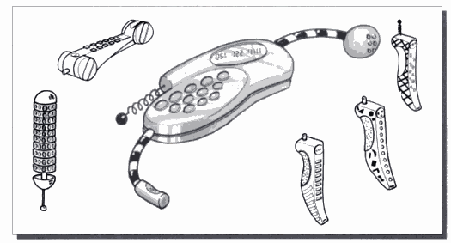
Step 6: Create environmental concepts
Create ideal concepts
CREATE IDEAL CONCEPTS
One of the ways in which to proceed with environmental improvements is to create so-called “ideal concepts”. An ideal concept is created with focus on one particular aspect, conceptualised in a ‘vacuum’, with respect to all other constraints.
Adventure mobile phone Fun mobile phone
[Baxter]

Slide 62
Step 6: Create environmental concepts
Ideal concept principle
  Recyclable materials
  Durability
  Energy intensity
Solution space
  Environmental features
  Service intensity
  Sustainable resources
  Sustainable supply chains

Slide 63

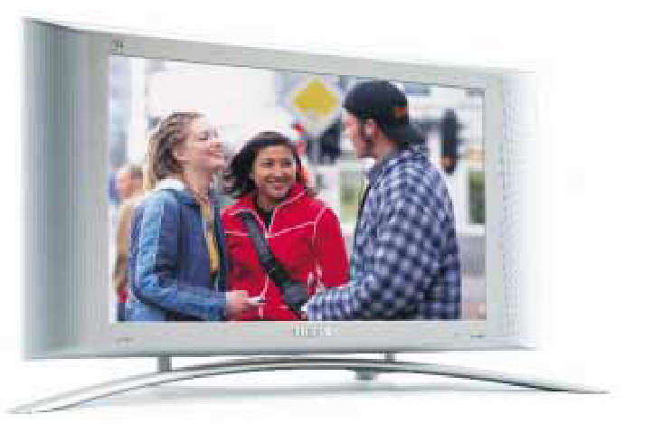
Step 6: Create environmental concepts
Ideal concept principle - example
  Sustainable materials (low weight)
  Energy intensity
Solution space

Slide 64
Step 6: Create environmental concepts
Create ideal concepts - example
Ecodesign principle
Apply the following ecodesign principle to create one or more new product concepts which have a radically improved environmental profile.
Ecodesign principle #2:
Exercise: Try to apply this ecodesign principle to the product you are working on, and see where, throughout the product’s lifecycle, the principle can be applied.
Reduce the energy intensity the product or service
As energy supply today is not based on 100% renewable sources, and as fuels often are fossile, the consumption of energy typically leads to environmental loads that can be reduced by changing the design.

Slide 65
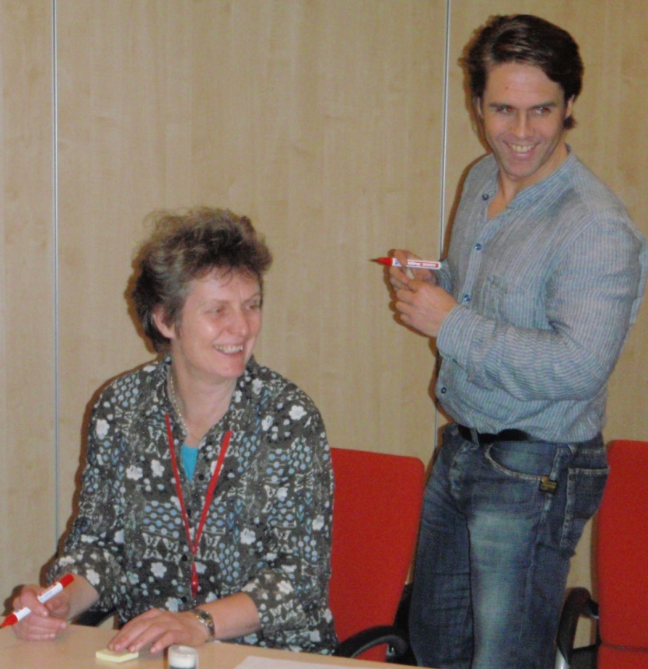
Step 6: Create environmental concepts
Negative brainstorming
BREAK DOWN THE MENTAL BARRIERS
Despite the logical approach behind using certain ecodesign principles, one can often meet a barrier when attempting to create significant environmental improvements. The more one focuses on the need for good solutions, the harder it can be to find them.
Humans seem actually to be designed in such a way that it is easier for us to imagine all the ways in which to make the product environmentally worse, and not the opposite!
A negative brainstorm is therefore always easy (and fun) to perform, because it is the negative aspects that we want to move away from (and the negative aspects, which disturb the process of environmental concept generation). The task is therefore to imagine the world's most environmentally polluting product.

Slide 66
Step 6: Create environmental concepts
Negative brainstorming
STEP-BY-STEP APPROACH
Use 5-10 minutes in groups, brainstorming all the ways in which the environmental profile of your product can be made to be as bad as possible!
Write your ideas down on post-its (one idea per post-it).
Remember that brainstorm rules apply!
When all the negative ideas have emerged, they must be categorised in relation to the ecodesign principles.
The next step is to turn every negative idea into one or more positive ideas. For example, the idea “The pump is always on - no way of turning on/off” is addressing the ecodesign principle regarding energy and can be contradicted with various positive environmental ideas, such as “The pump has automatic flow regulation”.
The exercise is complete when all the negative ideas have been created, categorised and countered with a list of positive ideas.
Finally, identify five key environmental focus areas by putting a ‘*’ by the relevant environmental impacts.
  Choose 5 environmental ‘*’ priorities!

Slide 67
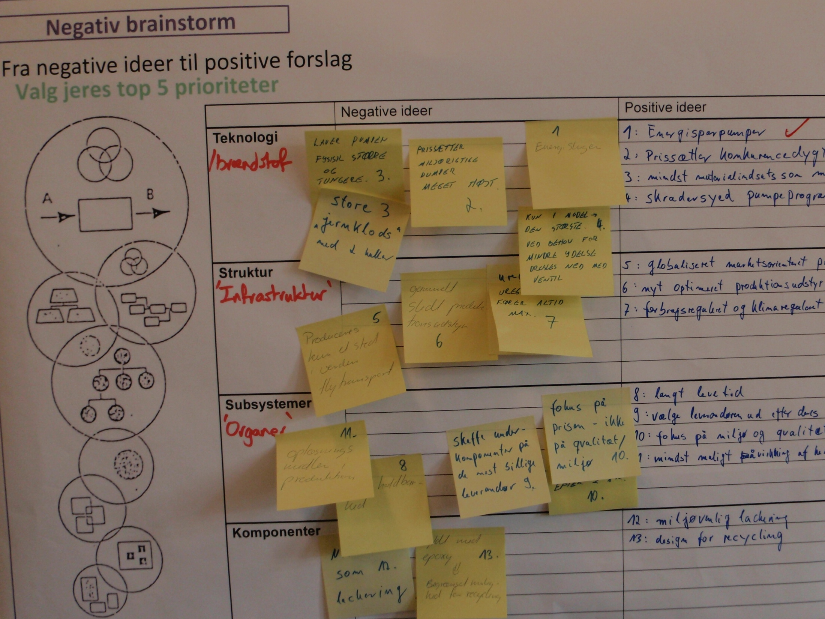
Step 6: Create environmental concepts
Negative brainstorming

Slide 68
Step 6: Create environmental concepts
WHY CARRY OUT THIS EXERCISE?
You create environmental concepts in this exercise by focusing on a selected number of environmental focus areas and developing approaches that eliminate the actual problem. The many technical professions represented in the workshop group should give high chances of creating target-worthy solutions.
Using the environmental principles helps to create guiding stars which help the conceptualisation process. The negative brainstorm exercise is suitable for a workshop setting, as the whole group can contribute and because there is not much time in a workshop for detailed conceptualisation.
The negative brainstorm exercise may initially seem unserious; but more often than not, the exercise helps to produce far more new and innovative ideas, than if one had systematically followed a traditional improvement strategy.
The many new ideas that were generated by the negative ones, can now be prioritised and built into the product development task for further development. The creation of the ideal concepts helps to pan out the solution space for new environmental concepts.

Slide 69
THE PROCESS THAT YOU HAVE NOW COMPLETED IN STEPS 1 TO 6 HAS BEEN A CREATIVE PROCESS WITH A SOLE FOCUS ON THE ENVIRONMENT.
NOW IS THE TIME TO REFLECT:
HOW SHOULD THE EXPERIENCES FROM THIS PROCESS SHAPE THE COMPANY'S STRATEGY AND POLICY?
HOW SHOULD SUCH ACTIVITIES BE BUILT INTO THE PRODUCT DEVELOPMENT PROCESS IN THE FUTURE?

Slide 70
Environmental improvement through product development
Step 7: Develop an environmental strategy

Slide 71
Step 7: Develop an environmental strategy
BACKGROUND
For environmental efforts, ideas and requirements to become rooted in the organisation, a strategy and prioritisation of efforts is required.
The previous 6 steps in the 7-step approach have helped to develop ideas for environmental improvement by changing the product and its life cycle. If you have completed these steps carefully, you should now have a long list of environmental priorities and ideas!
The last task in this approach is to use your group’s experience, inspiration and opportunities to decide on an environmental strategy. You hereby leave the reference product you have been working on, in order to attempt a generalisation of the environmental product development effort for the whole company.
As a result of the first 6 steps of this approach, you now have 4 x 5 sets of environmental focus areas ‘*’. The task is now to consolidate these 20 environmental focus areas through dialogue within the group, into a smaller, more manageable number of environmental focus areas (choose, for example, the top 10). Targets must then be set for the degree of improvement expected for each environmental focus area.

Slide 72
Step 7: Develop an environmental strategy
Corporate values
Environmental policy and strategy
Environmental focus areas
Environment in product development
Ecodesign guidelines and actions
[McAloone]

Slide 73
Step 7: Develop an environmental strategy
STEP-BY-STEP APPROACH
For this task you should draw a radar plot, on which each of your chosen 10 environmental priorities are assigned an axis.
Choose an appropriate unit of measurement for each axis of the radar plot (e.g. kg, %, mg, J, km, number of years, or mPt).
Then use two colours to represent current status and future goal.
Assign responsibilities within the organisation, i.e. point to people who can take on the coordination of the task of creating the environmental improvements within each focus area.
When this exercise is carried out in a workshop setting it is often the case that, even if appropriate units have been selected for each environmental priority, it is not possible to commit to absolute and quantified improvements for each focus area. Therefore, one can instead begin by operating with stepwise goals (e.g. a scale of 0-4) or relative improvements (e.g. factor 2, 3, 4 or “50% reduction”). These units can be adjusted later.

Slide 74
Step 7: Develop an environmental strategy
STEP-BY-STEP APPROACH
When the strategy proposals are in place, it is important to define the implementation task, so that the coordinators of each focus area can put deadlines on their activities and begin to make individual action plans for their tasks.
The task after this step is to work through the results of step 7, putting real numbers onto the units of each axis of the radar plot and then developing a comprehensive environmental action plan.
Use this poster (electronic version available) to plot out an environmental strategy

Slide 75
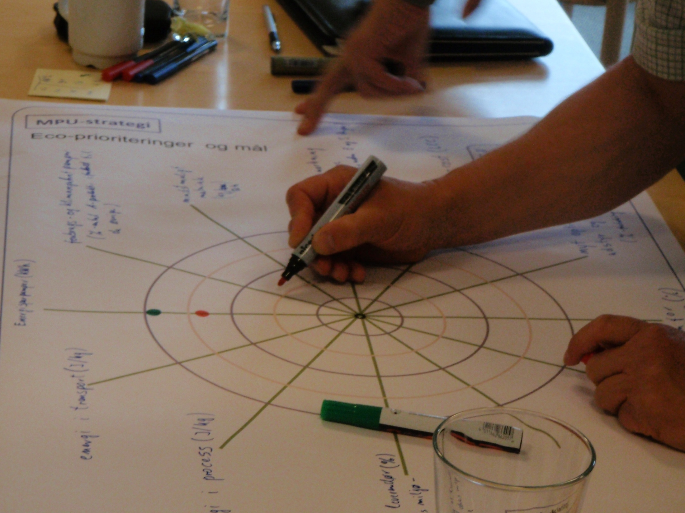
Step 7: Develop an environmental strategy

Slide 76
Environmental improvement through product development
Ensuring implementation in the company

Slide 77
Ensuring implementation in the company
It is a challenging process after the workshop to ensure that the ideas, priorities and tools find a place in the company.
As indicated in Step 7, the environmental considerations should be aligned to the company's overall development. Objectives, strategies and action plans should therefore be coordinated with other initiatives.
The selection of one or more dedicated coordinators is the first step in this process. In relation to the company management, the coordinator has the major task of communicating and mediating the environmental effort with the company's other objectives and strategies.
If the resources can be devoted to the positive and systematic environmental improvement in the company, it is certain that the investment will pay off in several areas:
  Meeting the company's social obligations
  Prevention in relation to future environmental concerns and requirements
  Demonstrating the company's environmental stance
  Improved view of and influence over the product life cycle
  A service-oriented view of the product
  Robust and innovative product concepts.

Slide 78
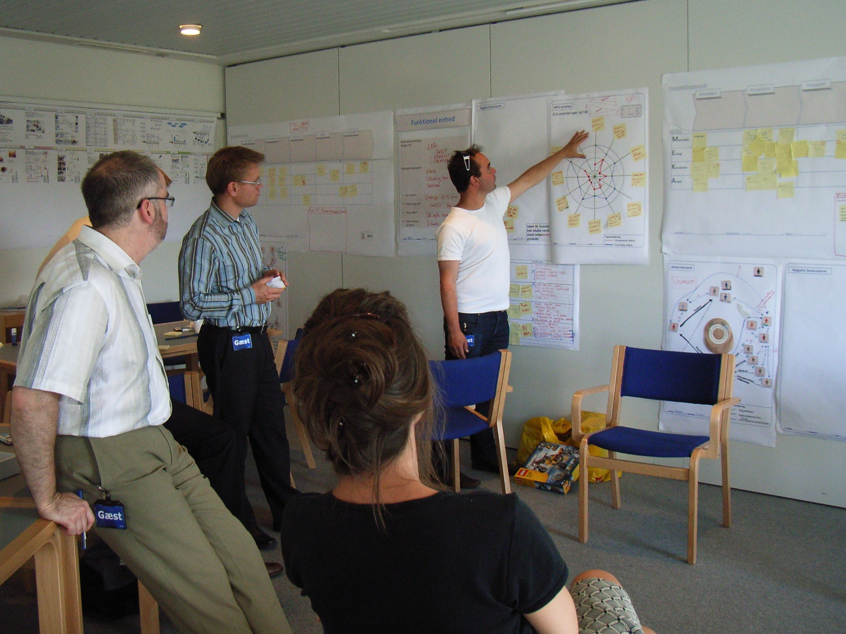
Ensuring implementation in the company

Slide 79


For further information
Tim McAloone
DTU Management Engineering
Engineering Design and Product Development
Building 426, Produktionstorvet, DK-2800 Kgs. Lyngby
Denmark
Telephone (+45) 4525 6270
Homepage www.kp.man.dtu.dk/english/research/areas/ecodesign/guide
Email tmca@man.dtu.dk

