Slide 1
Environmental improvement through product development
Step 1: Describe the use context

Slide 2
Step 1: Describe the use context
BACKGROUND
Aim: To reach a common understanding of the product and its value contribution under use.
Objective: To describe the product's functionality to the user. This description provides the benchmark for all subsequent decisions and can also be used when, for example, alternative concepts shall be compared.
Exercise: Describe the use context by answering the following questions:
  What should the product be used for?
  What does the product do?
    For whom?
    How long?
    How often?
    Where in the world?
Notes:
As the very first exercise, it is important to reach a common understanding of the product and its value contribution under use. This provides a common starting point for discussions about the environmental improvement possibilities for the product, which you will need later in the process, in order to create product alternatives. It is important that the product alternatives meet the same requirements for the customer. Redundant product attributes should be considered as waste, both from an environmental and a customer perspective.
Step 1 is therefore intended to reach a description of the product's functionality to the user. This description provides the benchmark for all subsequent decisions and can also be used when, for example, alternative concepts shall be compared.
The use context can be described by answering the following questions:
What should the product be used for?
What does the product do?
For whom?
How long?
How often?
Where in the world?

Slide 3
Step 1: Describe the use context
BACKGROUND
“What should the product be used for?” leads to a description of the basic task that the product must carry out for the user.
“What does the product do?” allows for a description of the product's functionality, including the technological principle and the features that the product must possess in order to deliver the service to the user. Sub-functions may, for example, be "to stick to the skin" or "to turn electrical energy into rotary motion".
“... For whom?” leads to a description of the main user or user group.
“... How long?” and “... how often?” lead to a definition of the time frames and use patterns in which the product must operate.
“... Where in the world?” leads to a definition of the geographical area in which the product must operate and probably will be disposed of.
All in all, these responses lead to a clear description of the product in the form of the value contribution that the product delivers to the user.

Slide 4
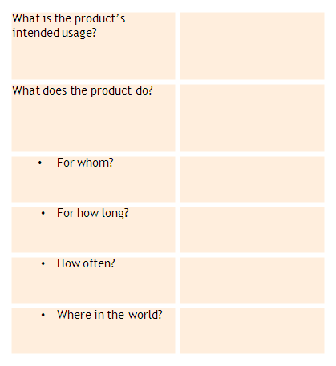
Step 1: Describe the use context
STEP-BY-STEP APPROACH
Write the questions on a large piece of paper.
Answer the questions in your group, based on your knowledge of the product and insight into users' use of the product.
Some of the questions can be answered by looking at the product specification (or the business specification, if the product has not yet been developed).
The exercise is complete when the group has obtained a detailed picture of the product's functions and raison d'être, seen from the user’s viewpoint.
Using this poster (electronic version available) discuss the product and its use context

Slide 5
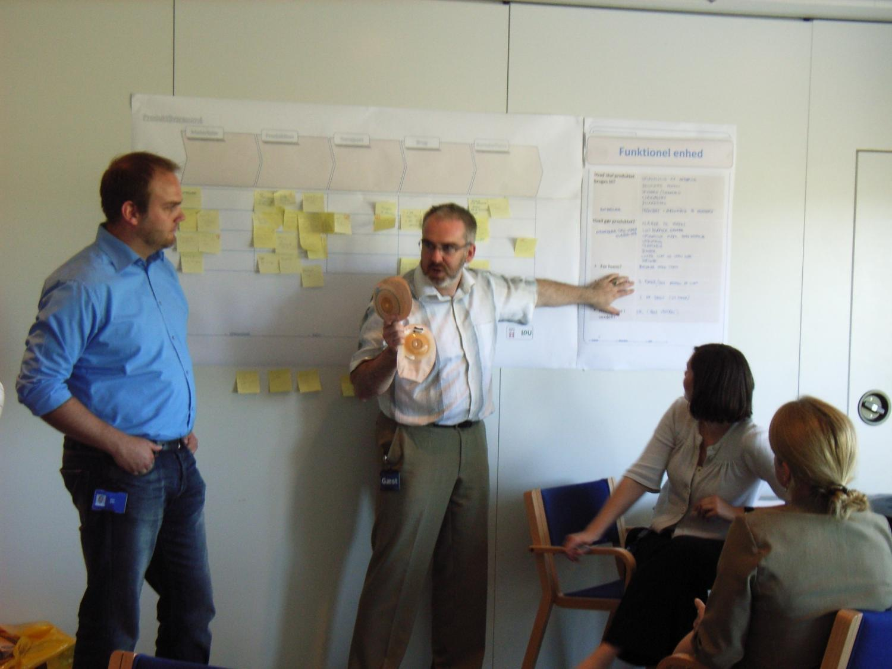
Step 1: Describe the use context

Slide 6
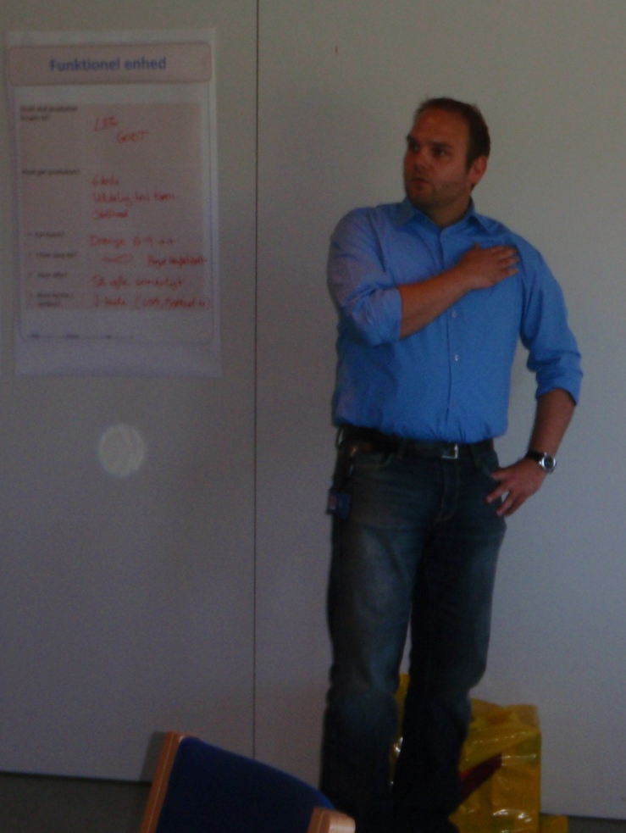
Step 1: Describe the use context
WHY CARRY OUT THIS EXERCISE?
To ensure a common frame of reference for the workshop, within the group
To define a typical product to be used for the rest of the process
It is crucial that the answers to the six questions in this step form a documented description that the project team agrees upon
Remember to provide sufficient detail to allow comparisons with the alternative concepts later on in the process
Notes:
Despite the fact that all group members already have their own understanding of the product, its use and use context, it is beneficial to carry out this initial discussion of the product's use context in order to agree on a common frame of reference.
There are often several versions of the product and various markets (possibly worldwide). It is therefore important in this initial exercise to define a typical product to be used for the rest of the process.
It is crucial that the answers to the six questions in this step form a documented description that the project team agrees upon, and which is sufficiently detailed to allow comparisons with the alternative concepts later on in the process.

Slide 7


For further information
Tim McAloone
DTU Management Engineering
Engineering Design and Product Development
Building 426, Produktionstorvet, DK-2800 Kgs. Lyngby
Denmark
Telephone (+45) 4525 6270
Homepage www.kp.man.dtu.dk/english/research/areas/ecodesign/guide
Email tmca@man.dtu.dk

