Slide 1
Environmental improvement through product development
Step 3: Create your environmental profile and find root causes

Slide 2
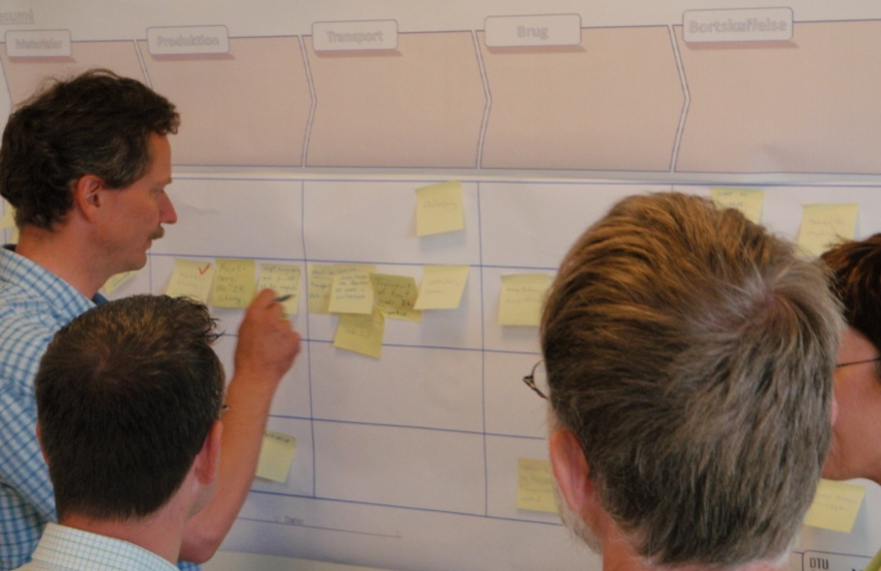
Step 3: Environmental profile and root causes
BACKGROUND
This step will lead you through an organisation of the environmental impacts, according to their type.
The idea is to create a more transparent picture of the physical relationships that underpin each environmental focus area
The already identified environmental impacts will now be organised into one of four categories:
  Materials
  Energy
  Chemicals
  Other
Notes:
After having created an overview of the product’s main life stages and environmental impacts in Step 2, this step will lead you through an organisation of the environmental impacts, according to their type. Subsequently you will make a note of the possible causes for the environmental impacts’ emergence.
The idea here is to create a more transparent picture of the physical relationships that underpin each environmental focus area. A number of focus areas will then be prioritised, based on your consideration of the need for action.
The already identified environmental impacts will now be organised into one of four categories: Materials, Energy, Chemicals or Other.

Slide 3
Step 3: Environmental profile and root causes
BACKGROUND
Materials: Includes resource and disposal aspects of each life cycle stage. Remember also to consider whether ancillary materials are used, particularly in the use phase, such as paper filters for coffee makers.
Energy: Includes energy sources and energy aspects in the product life stages. Remember also to consider component suppliers. The transport and use-related energy consumption is also recorded under this category.
Chemicals: Includes chemical consumption and chemical-related emissions of each life cycle stage.
Other: All other aspects can be noted here, e.g. health & safety, Corporate Social Responsibility (CSR), general economical concerns, etc.
This categorisation of the environmental impacts is created in a so-called MECO-matrix.
Notes:
Materials: This includes resource and disposal aspects of each life cycle stage, i.e. whether a material is based on a scarce resource, whether it can be easily recycled, or whether it must be landfilled, etc. Remember also to consider whether ancillary materials are used, particularly in the use phase, such as paper filters for coffee makers.
Energy: This includes energy sources and energy aspects in the product life stages. There can, for example, be large differences in energy consumption for material processing, depending on whether one takes new or recycled raw materials into consideration. Remember also to consider component suppliers. The transport and use-related energy consumption is also recorded under this category.
Chemicals: This includes chemical consumption and chemical-related emissions of each life cycle stage, such as toxic chemicals used in manufacture or in the materials.
Other: In this category all other aspects are noted, that one has chosen to consider. For example, health and safety in own (or suppliers’) manufacturing plants, aspects related to Corporate Social Responsibility (CSR), or general economical concerns.
This categorisation of the environmental impacts is created in a so-called MECO-matrix.

Slide 4
Step 3: Environmental profile and root causes
STEP-BY-STEP APPROACH
Draw a 4x5 MECO-matrix directly under the product life résumé from Step 2.
Move the post-it notes from the product life résumé, down to the MECO-matrix.
  Consider each environmental impact in turn, placing them in the most relevant MECO-field.
Make duplicates if relevant
This exercise is complete when all the post-it notes have been moved down to MECO-matrix.
Materials
Manufacture
Transport
Use
Disposal
Materials
Miljøvenli
For
Mindst
ge
meget
muligt
materiale
vægt
materiale
r
(støbejer
-
indsats
n)
?
  Choose 5 environmental ‘*’ priorities!
Mindre
Reduceret
ressourc
forbrug af
er
Cu og Fe.
Men brug af
Ncl og
Energy
elektronik
Meget
Produktio
energifor
ns
brug
teknologi/
under
energieff
fremstillin
ektiv
g af
P?
-
Energifor
magneter
brug
under
Produktionsfremstilling
produkt
-
Energi
udvikling
Chemicals
(F.eks. støbeproces)
Brug af
giftige
materialer
(ex. bly,
kviksølv)
Other
Using this poster (electronic version available) move the post-it notes down into the MECO categories and then find five * priorities
Notes:
Draw a MECO-matrix directly under the product life résumé from Step 2. The MECO-matrix should be a 4x5 matrix with space for the post-it notes, which are currently distributed on the product life résumé.
In dialogue with your group, move the post-it notes from the product life résumé, down to the MECO-matrix. Consider each environmental impact in turn, placing them in the most relevant MECO-field.
If an environmental impact covers two or more MECO-fields, copy the post-it note and then place one in each relevant field.
The first part of this exercise is complete when all the post-it notes have been moved down to MECO-matrix.

Slide 5
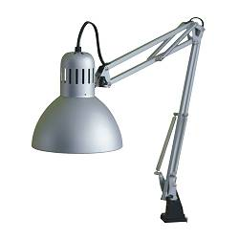

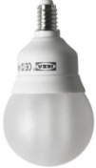
Step 3: Environmental profile and root causes
Example: Comparison of energy-saving bulb with incandescent bulb
Life cycle data:
  Home-use work lamp, 5 years life time
  Comparison:
  Lamp with regular bulbs vs. energy-saving bulbs
  Functional Unit/Service provided: “Provision of light
  (≈ 400 lu) for home workplaces for 5 years (i.e. 10,000 hrs. light) in Denmark”
  Materials
  Lamp, ≈ 1kg: Steel (sheets, springs, tubes, screws), various polymers, copper
  Regular bulb, 60 W, 33g: Glass, nickel-coated tin, cardboard
  Energy-saving bulb, 11 W, 80g: Glass, polymers, electronics (PWB)
  Production: Manufacture and assembly in China
  Transport: 7,200 km transport to Denmark, i.e. 450 kgkm vs. 600 kgkm
  Use: 5 regular bulbs & 300 kWh vs. 1 energy-saving bulb & 55 kWh
  End-of-life: Household waste in Denmark

Slide 6
Step 3: Environmental profile and root causes
MECO (for incandescent bulb)
 | Materials stage | Production stage | Transport stage | Use stage | Disposal stage
Materials | Steel: 750g (net: 700g) Plastics: 200g (net: 170g) Glass: 30g (net: 25g) Cu: 25g (net: 20g) | (very low amounts of ancillary substances) |  |  | In household waste: 1 whole lamp; 5 regular bulbs (5x 33g, mostly glass)
Energy | Steel: 20 MJ Plastics: 16 MJ Glass: 0,3 MJ Cu: 2 MJ In total: ≈ 38 MJ | Incl. overhead Estimated total: ≈ 12 MJ | 450 kgkm 90% ship, 10% truck, i.e. ≈ 0,06 MJ | 300 kWh electricity, i.e. ≈ 2700 MJ | (very low, if at all from plastics incineration)
Chemicals | The List Of Undesirable Substances [LOUS, DK EPA 2004]: flame retardants socket? | The LOUS: E.g. Degreasing agents for painting proc. |  |  | If incinerated, potential dioxin formation from brominated flame retardants
Other | Global material sourcing | Manufacturing in China: E.g. Safe working environment? | Storage & handling in China: E.g. Safe working environment?

Slide 7
Step 3: Environmental profile and root causes
MECO (for energy-saving bulb)
 | Materials stage | Production stage | Transport stage | Use stage | Disposal stage
Materials | Steel: 750g (net: 700g) Plastics: 220g (net: 190g) Glass: 60g (net: 50g) Cu: 25g (net: 20g) | (very low amounts of ancillary substances) |  |  | In household waste: 1 whole lamp; 1 energy-saving bulb (mostly glass, plastics)
Energy | Steel: 20 MJ Plastics: 18 MJ Glass: 0,6 MJ Cu: 2 MJ In total: ≈ 41 MJ | Incl. overhead Estimated total: ≈ 14 MJ | 600 kgkm 90% ship, 10% truck, i.e. ≈ 0,8 MJ | 55 kWh electricity, i.e. ≈ 495 MJ | (very low, if at all from plastics incineration)
Chemicals | The List Of Undesirable Substances [LOUS, DK EPA 2004]: Brominated flame retardants (in plastic socket)? Subst. related to electronics? | The LOUS: E.g. Degreasing agents for painting proc. |  |  | If incinerated, potential dioxin formation from brominated flame retardants
Other | Global material sourcing | Manufacturing in China: E.g. Safe working environment? | Storage & handling in China: E.g. Safe working environment?

Slide 8
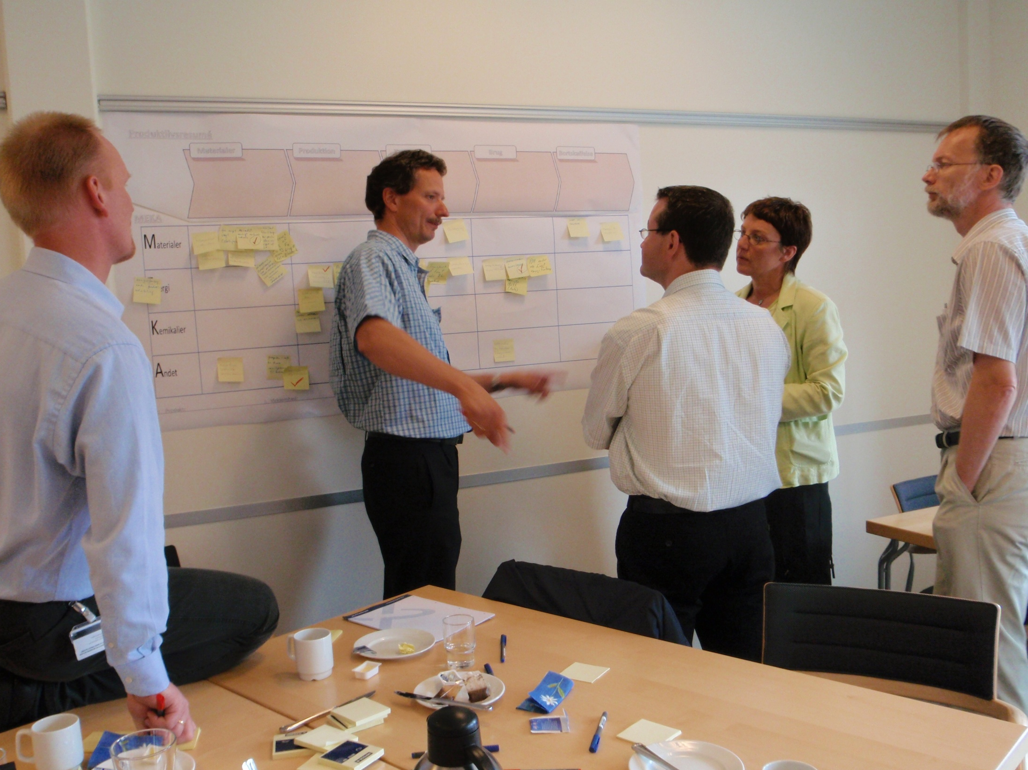
Step 3: Environmental profile and root causes

Slide 9
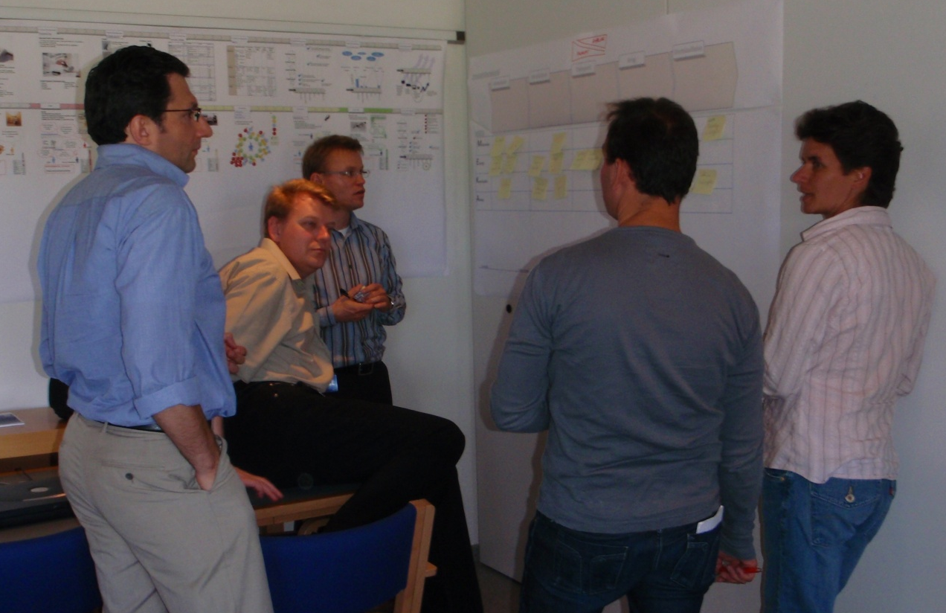
Step 3: Environmental profile and root causes
WHY CARRY OUT THIS EXERCISE?
Experience shows that there is a tendency to try to fill the entire MECO-matrix if you hadn’t completed step 2 first
Important opportunity for project group to create a structured step-by-step overview of whole life cycle and related impacts
Notes:
In principle, you could have started the whole environmental profiling process by filling in the MECO-matrix, i.e. skipping steps 1 and 2. But experience shows that there is a tendency to try to fill the entire MECO-matrix, even though there may not be relevant environmental impacts in every single field of the MECO-matrix.
If the product's use context has not previously been discussed, and if the group has not first had the opportunity to carry out the slightly more unstructured exercise in step 2, confusion can arise with respect to where the environmental impacts actually are in the product.

Slide 10


For further information
Tim McAloone
DTU Management Engineering
Engineering Design and Product Development
Building 426, Produktionstorvet, DK-2800 Kgs. Lyngby
Denmark
Telephone (+45) 4525 6270
Homepage www.kp.man.dtu.dk/english/research/areas/ecodesign/guide
Email tmca@man.dtu.dk

