Slide 1
Environmental improvement through product development
Step 7: Develop an environmental strategy

Slide 2
Step 7: Develop an environmental strategy
BACKGROUND
For environmental efforts, ideas and requirements to become rooted in the organisation, a strategy and prioritisation of efforts is required
If you have completed steps 1-6 carefully, you should now have a long list of environmental priorities and ideas!
This task is focused on deciding on an environmental strategy, based on the priorities you have identified
  At the same time you must now think generically in terms of a strategy for all products in the company
As a result of the first 6 steps of this approach, you now have 4 x 5 sets of environmental focus areas ‘*’. The task is now to consolidate these 20 environmental focus areas through dialogue within the group, into a smaller, more manageable number of environmental focus areas (choose, for example, the top 10). Targets must then be set for the degree of improvement expected for each environmental focus area.
Notes:
BACKGROUND
For environmental efforts, ideas and requirements to become rooted in the organisation, a strategy and prioritisation of efforts is required.
The previous 6 steps in the 7-step approach have helped to develop ideas for environmental improvement by changing the product and its life cycle. If you have completed these steps carefully, you should now have a long list of environmental priorities and ideas!
The last task in this approach is to use your group’s experience, inspiration and opportunities to decide on an environmental strategy. You hereby leave the reference product you have been working on, in order to attempt a generalisation of the environmental product development effort for the whole company.
As a result of the first 6 steps of this approach, you now have 4 x 5 sets of environmental focus areas ‘*’. The task is now to consolidate these 20 environmental focus areas through dialogue within the group, into a smaller, more manageable number of environmental focus areas (choose, for example, the top 10). Targets must then be set for the degree of improvement expected for each environmental focus area.

Slide 3
Step 7: Develop an environmental strategy
Corporate values
Environmental policy and strategy
Environmental focus areas
Environment in product development
Ecodesign guidelines and actions
[McAloone]

Slide 4
Step 7: Develop an environmental strategy
STEP-BY-STEP APPROACH
For this task you should draw a radar plot, on which each of your chosen 10 environmental priorities are assigned an axis.
Choose an appropriate unit of measurement for each axis of the radar plot (e.g. kg, %, mg, J, km, number of years, or mPt).
Then use two colours to represent current status and future goal.
Assign responsibilities within the organisation, i.e. point to people who can take on the coordination of the task of creating the environmental improvements within each focus area.
When this exercise is carried out in a workshop setting it is often the case that, even if appropriate units have been selected for each environmental priority, it is not possible to commit to absolute and quantified improvements for each focus area. Therefore, one can instead begin by operating with stepwise goals (e.g. a scale of 0-4) or relative improvements (e.g. factor 2, 3, 4 or “50% reduction”). These units can be adjusted later.

Slide 5
Step 7: Develop an environmental strategy
STEP-BY-STEP APPROACH
When the strategy proposals are in place, it is important to define the implementation task, so that the coordinators of each focus area can put deadlines on their activities and begin to make individual action plans for their tasks.
The task after this step is to work through the results of step 7, putting real numbers onto the units of each axis of the radar plot and then developing a comprehensive environmental action plan.
Use this poster (electronic version available) to plot out an environmental strategy

Slide 6
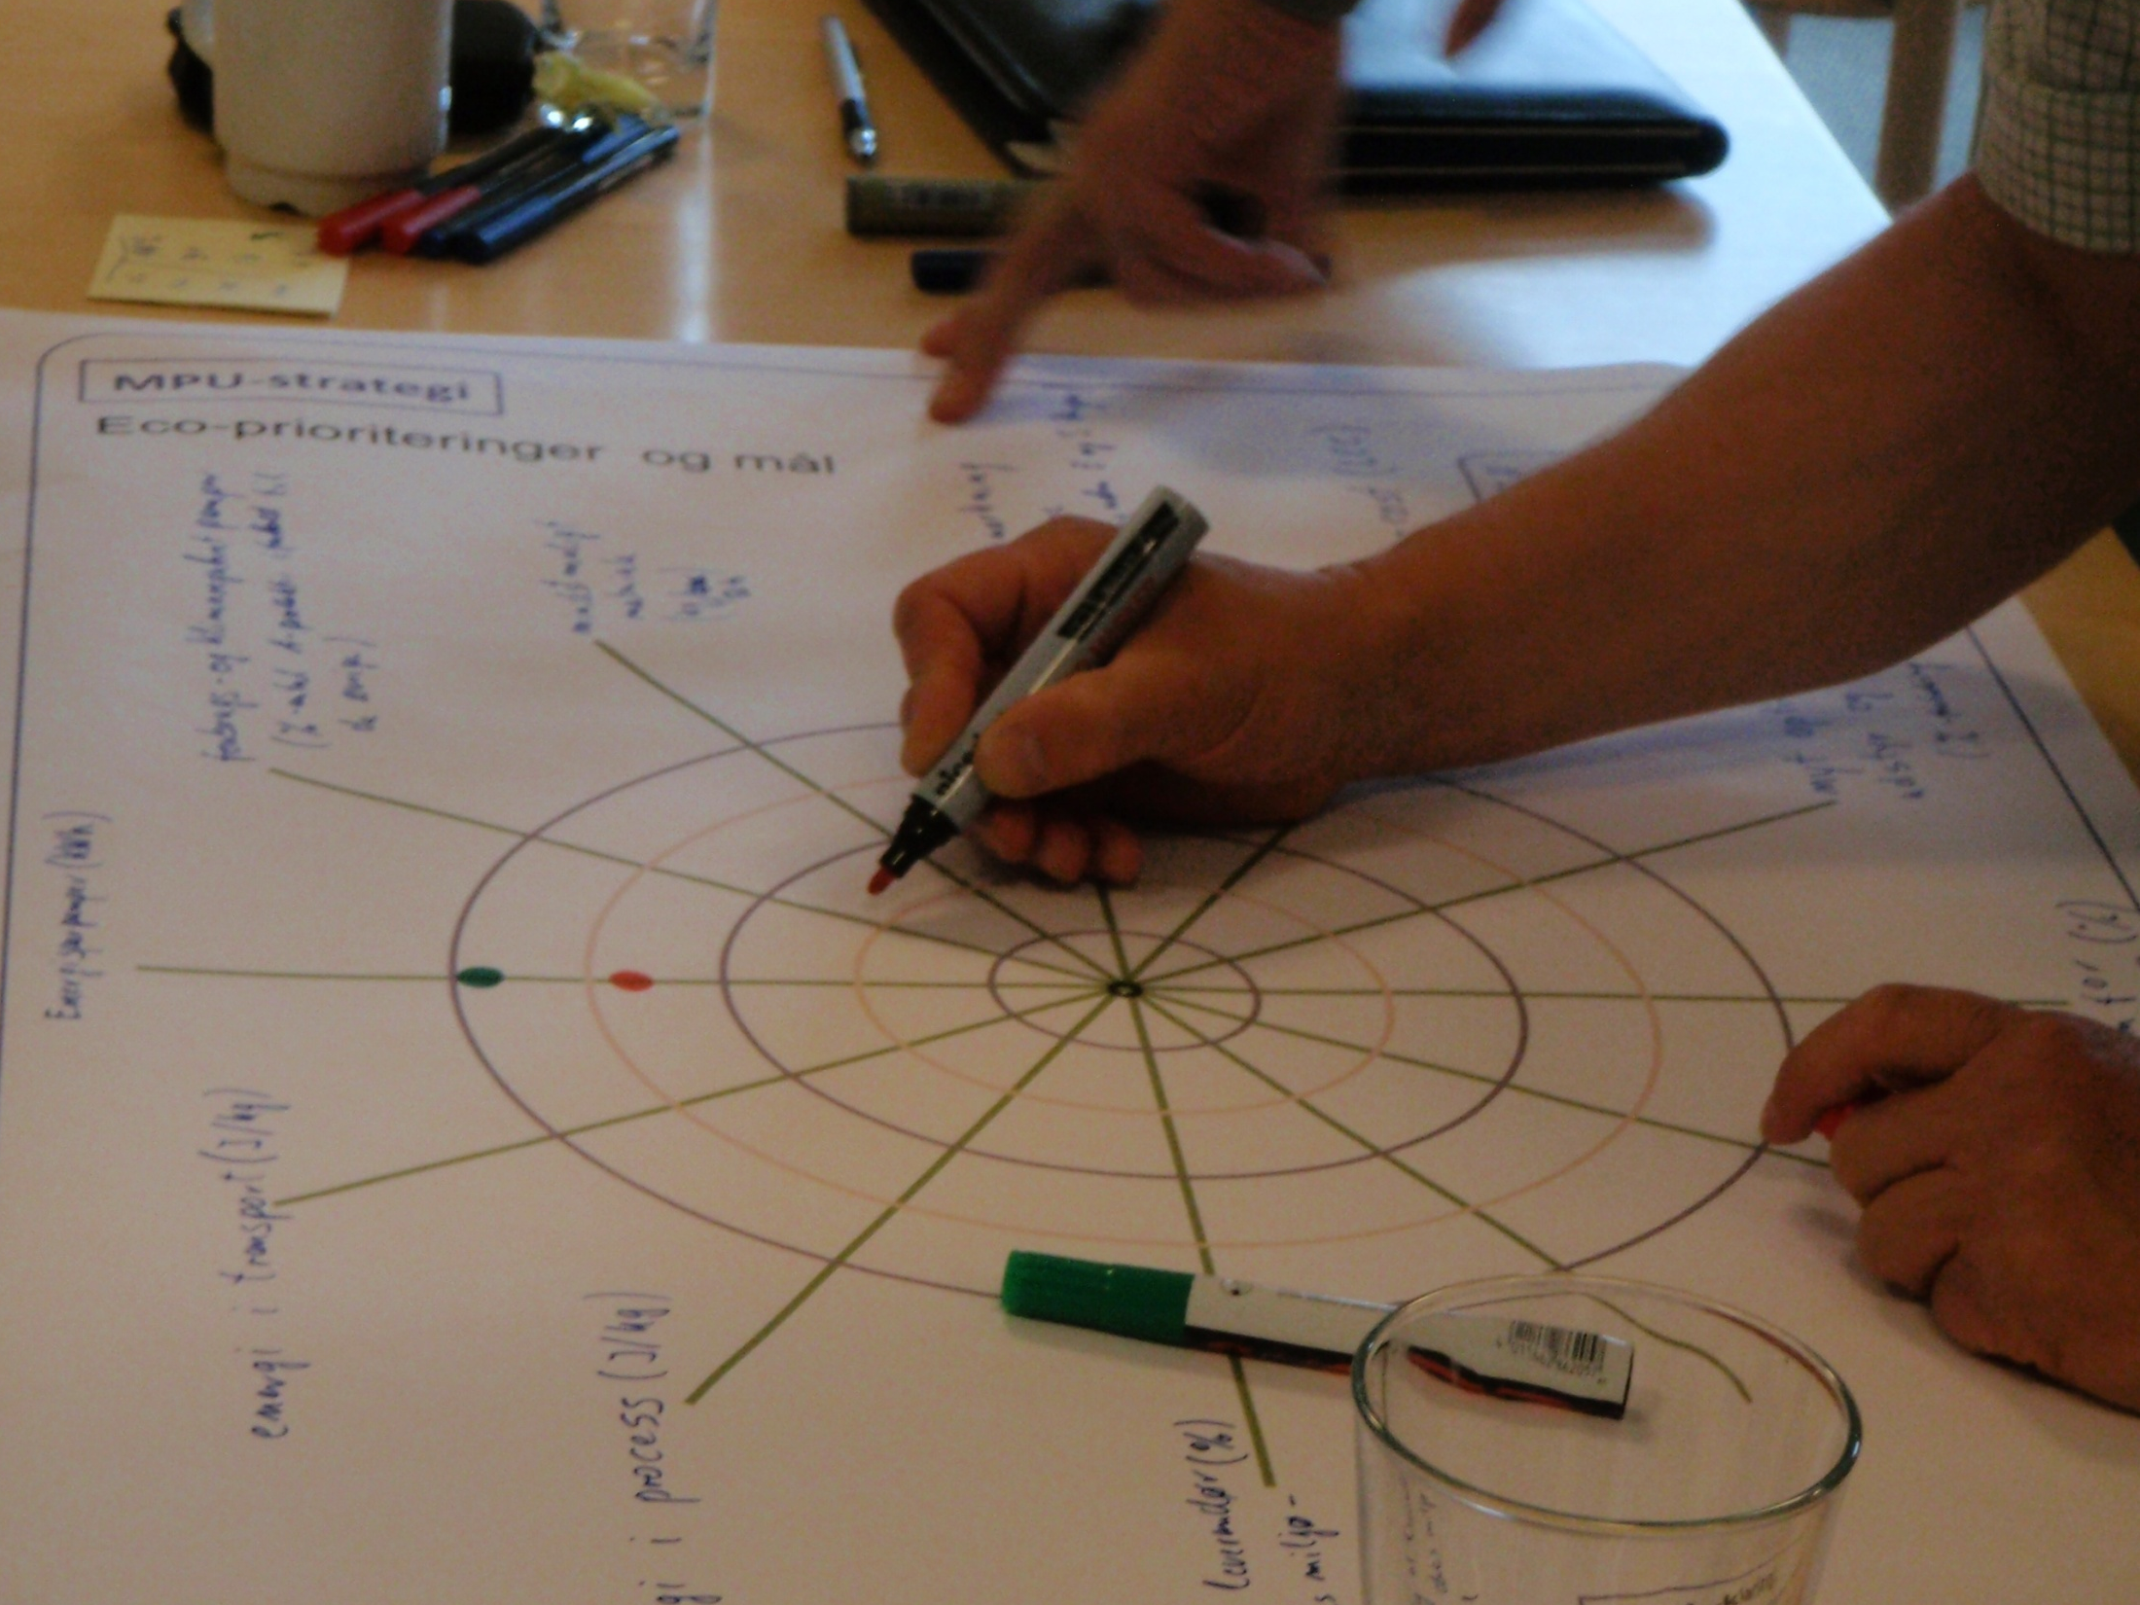
Step 7: Develop an environmental strategy

Slide 7


For further information
Tim McAloone
DTU Management Engineering
Engineering Design and Product Development
Building 426, Produktionstorvet, DK-2800 Kgs. Lyngby
Denmark
Telephone (+45) 4525 6270
Homepage www.kp.man.dtu.dk/english/research/areas/ecodesign/guide
Email tmca@man.dtu.dk

