Slide 1
Environmental improvement through product development
Step 6: Create environmental concepts

Slide 2
Step 6: Create environmental concepts
BACKGROUND
This task focuses on the creation of environmental concepts for the product and it's life cycle
There are various types of tools available to aid this task:
  Brainstorming, brainwriting, sketching, etc.
  Checklists and negative checklists to prompt environmental thinking
  Future scenarios, in order to make a leap forward and perhaps find radical environmental concepts
  Ecodesign principles, to inspire and guide the environmental conceptualisation process
    These are detailed on the next slide
Notes:
BACKGROUND
In this task you will create solutions for the product and the product's life cycle, which can lead to environmental improvements. Based on the series of environmental insights that you have gained during the previous five steps, it is now time to start creating environmental concepts for the product.
There are various tools available to aid this task:
Those, which you have always used in product development - brainstorming, brainwriting, sketching, etc.
There are checklists and negative checklists, which prompt environmental thinking.
You can create future scenarios (e.g. “Outline the world's least energy-consuming house, which can be realised in the year 2020”) in order to make a leap forward and perhaps find radical environmental concepts.
The largest help is most likely to be gained by identifying relevant ecodesign principles that can inspire and guide the environmental conceptualisation process.

Slide 3
Step 6: Create environmental concepts
ECODESIGN PRINCIPLES
  Reduce the material intensity of the product or service
  Reduce the energy intensity of the product or service
  Reduce the dispersion of harmful substances through the product
  Increase the amount of recycled and recyclable materials in the product
  Optimise the product’s durability
  Incorporate environmental features into the product
  Signal the product’s environmental features through the physical design
  Maximise the use of sustainable resources and supply chains
  Optimise the product’s service intensity
  Design the life cycle first and then the product

Slide 4
Step 6: Create environmental concepts
Create ideal concepts
CREATE IDEAL CONCEPTS
Ideal concept = solution proposal focusing on a single optimisation parameter.
Ecodesign principles can be used to create a number of ideal concepts, optimised towards:
  Minimum material content in the product
  Minimum energy use throughout the product's life cycle
  Minimum content of toxic substances
  Optimal reusability
  Optimal durability
  Inbuilt environmental functions in the product
  Clarification of the environmental characteristics of the product
  etc.
Use an hour on each of the above optimisation proposals (you could also add some of your own) and produce a poster for each concept with brief explanations for specific characteristics, etc.
Notes:
CREATE IDEAL CONCEPTS
An ideal concept is a solution proposal, which is exclusively focused on a single optimisation parameter. The aforementioned ecodesign principles can be used to create a number of ideal concepts that, for example, are optimised towards:
Minimum material content in the product
Minimum energy use throughout the product's life cycle
Minimum content of toxic substances
Optimal reusability
Optimal durability
Inbuilt environmental functions in the product
Clarification of the environmental characteristics of the product
Use an hour on each of the above optimisation proposals (you could also add some of your own) and produce a poster for each concept with brief explanations for specific characteristics, etc. The posters will show how far each ecodesign principle can be stretched for the current product. Good sub-solutions can then be chosen from ideal concepts, in order to construct one or more concrete and realistic environmental product concepts.

Slide 5
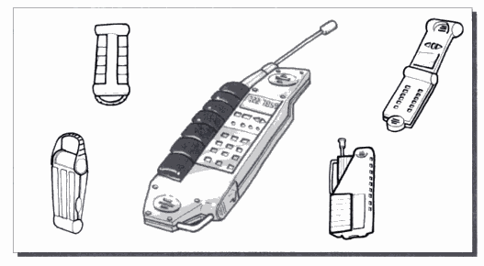
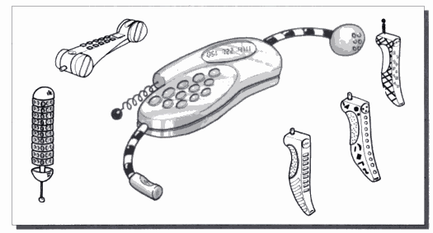
Step 6: Create environmental concepts
Create ideal concepts
CREATE IDEAL CONCEPTS
One of the ways in which to proceed with environmental improvements is to create so-called “ideal concepts”. An ideal concept is created with focus on one particular aspect, conceptualised in a ‘vacuum’, with respect to all other constraints.
Adventure mobile phone Fun mobile phone
[Baxter]

Slide 6
Step 6: Create environmental concepts
Ideal concept principle
  Recyclable materials
  Durability
  Energy intensity
Solution space
  Environmental features
  Service intensity
  Sustainable resources
  Sustainable supply chains

Slide 7

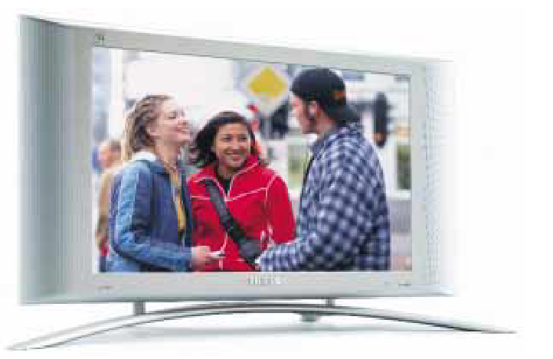
Step 6: Create environmental concepts
Ideal concept principle - example
  Sustainable materials (low weight)
  Energy intensity
Solution space

Slide 8
Step 6: Create environmental concepts
Create ideal concepts - example
Ecodesign principle
Apply the following ecodesign principle to create one or more new product concepts which have a radically improved environmental profile.
Ecodesign principle #2:
Exercise: Try to apply this ecodesign principle to the product you are working on, and see where, throughout the product’s lifecycle, the principle can be applied.
Reduce the energy intensity the product or service
As energy supply today is not based on 100% renewable sources, and as fuels often are fossile, the consumption of energy typically leads to environmental loads that can be reduced by changing the design.

Slide 9
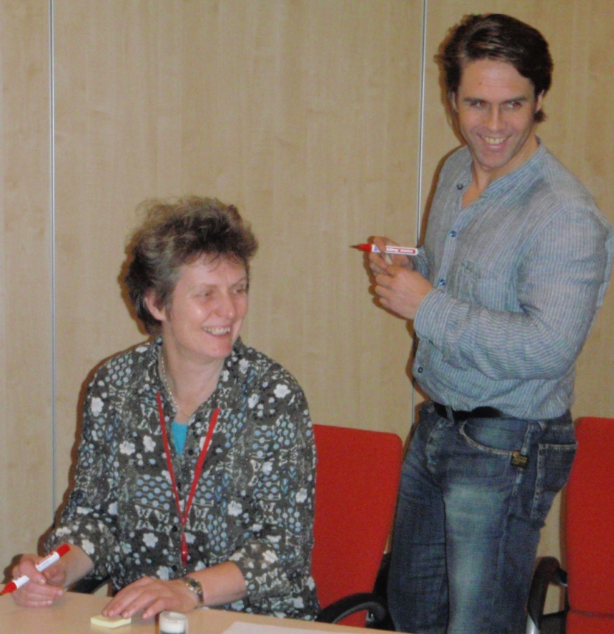
Step 6: Create environmental concepts
Negative brainstorming
BREAK DOWN THE MENTAL BARRIERS
One can often meet a barrier when attempting to create significant environmental improvements; the more one focuses on the need for good solutions, the harder it can be to find them.
So instead, let’s imagine all the ways in which to make the product environmentally worse, not the opposite!
A negative brainstorm is therefore always easy (and fun) to perform, because it is the negative aspects that we want to move away from (and the negative aspects, which disturb the process of environmental concept generation).
The task is therefore to imagine the world's most environmentally polluting product!
Notes:
BREAK DOWN THE MENTAL BARRIERS
Despite the logical approach behind using certain ecodesign principles, one can often meet a barrier when attempting to create significant environmental improvements. The more one focuses on the need for good solutions, the harder it can be to find them.
Humans seem actually to be designed in such a way that it is easier for us to imagine all the ways in which to make the product environmentally worse, and not the opposite!
A negative brainstorm is therefore always easy (and fun) to perform, because it is the negative aspects that we want to move away from (and the negative aspects, which disturb the process of environmental concept generation). The task is therefore to imagine the world's most environmentally polluting product.

Slide 10
Step 6: Create environmental concepts
Negative brainstorming
STEP-BY-STEP APPROACH
Use 5-10 minutes in groups, brainstorming all the ways in which the environmental profile of your product can be made to be as bad as possible!
Write your ideas down on post-its (one idea per post-it).
Remember that brainstorm rules apply!
When all the negative ideas have emerged, they must be categorised in relation to the ecodesign principles.
The next step is to turn every negative idea into one or more positive ideas.
The exercise is complete when all the negative ideas have been created, categorised and countered with a list of positive ideas.
Finally, identify five key environmental focus areas by putting a ‘*’ by the relevant environmental impacts.
  Choose 5 environmental ‘*’ priorities!

Slide 11
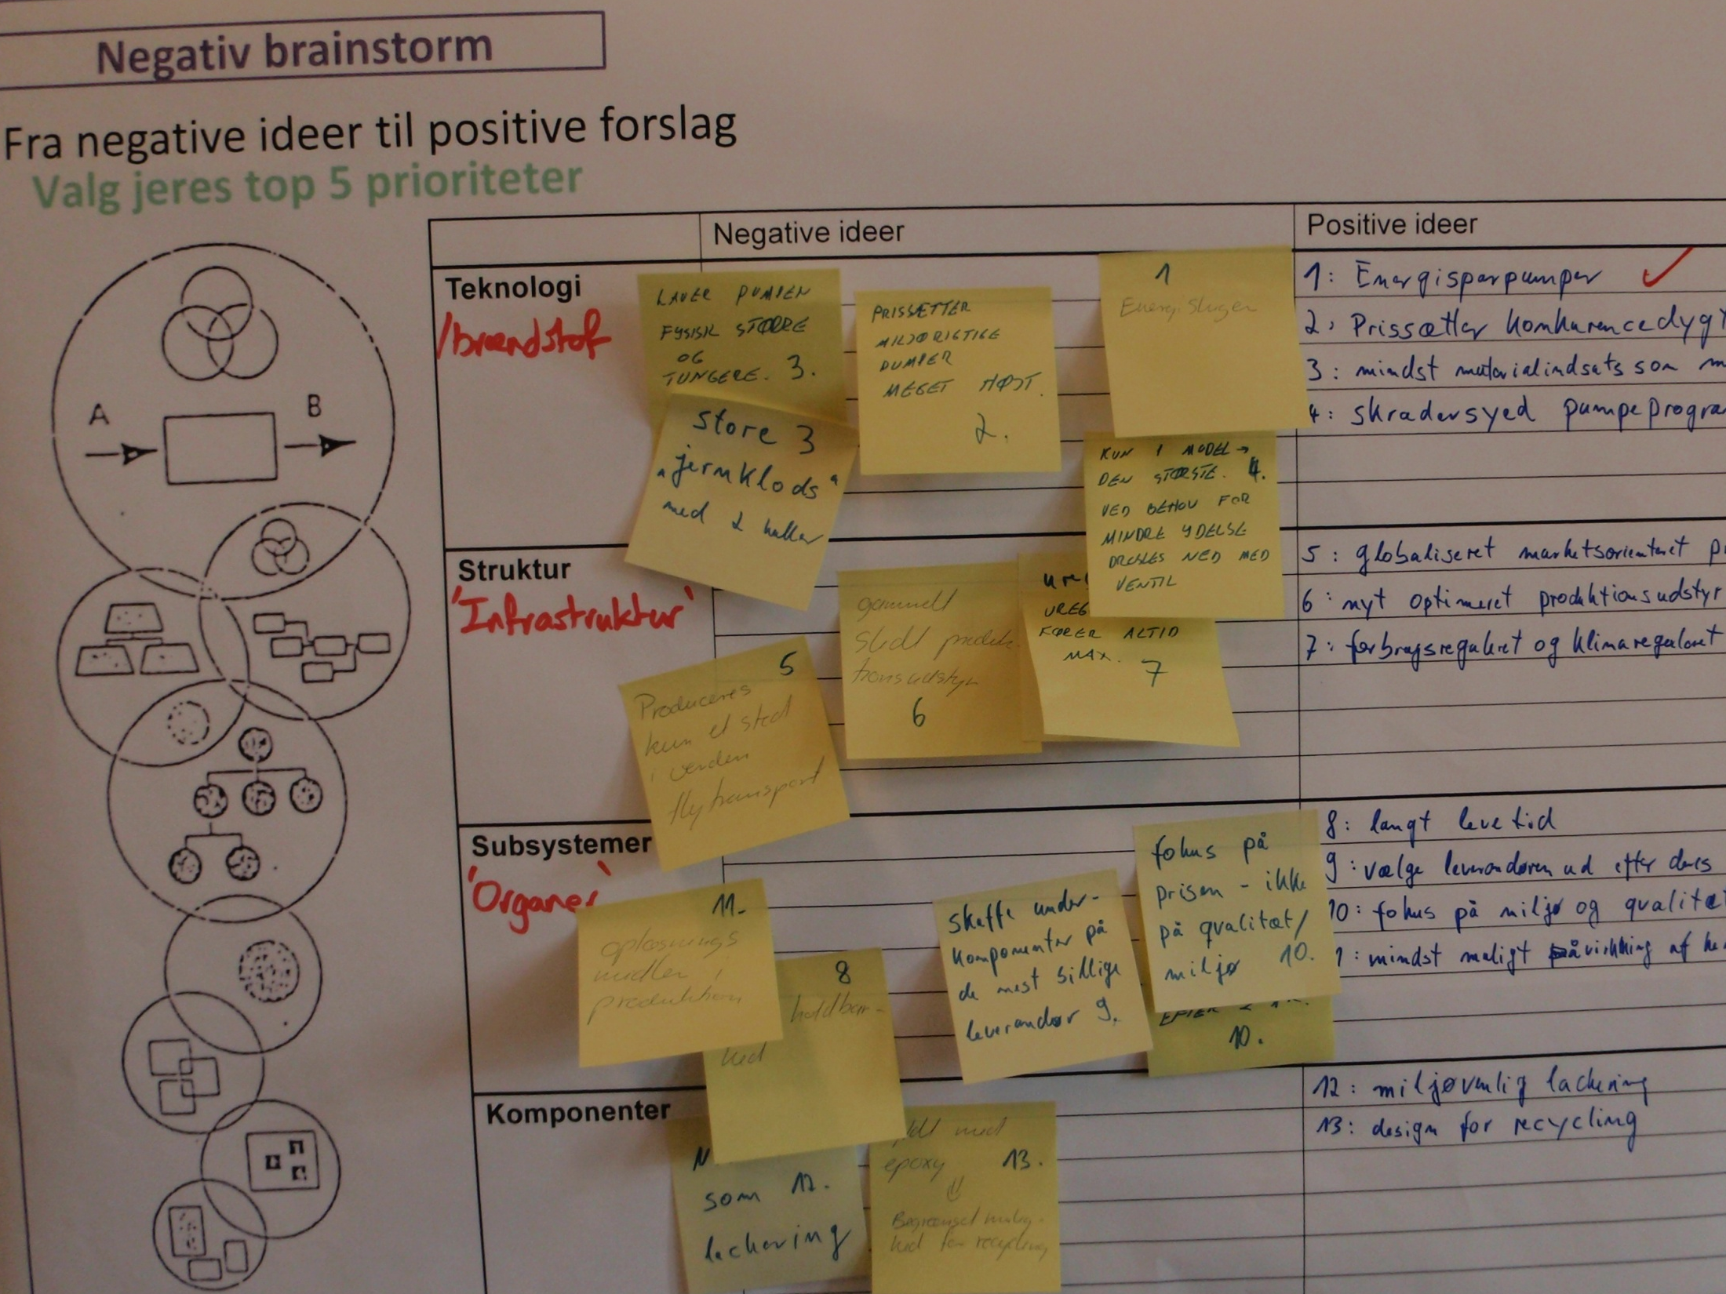
Step 6: Create environmental concepts
Negative brainstorming

Slide 12
Step 6: Create environmental concepts
WHY CARRY OUT THIS EXERCISE?
In order to identify and work on a selected number of environmental focus areas and develop approaches that eliminate the actual problem
The negative brainstorm exercise is suitable for a workshop setting, as the whole group can contribute
The negative brainstorm exercise may initially seem unserious; but more often than not, the exercise helps to produce far more new and innovative ideas, than if one had systematically followed a traditional improvement strategy
The many new ideas that were generated by the negative ones, can now be prioritised and built into the product development task for further development
Notes:
WHY CARRY OUT THIS EXERCISE?
You create environmental concepts in this exercise by focusing on a selected number of environmental focus areas and developing approaches that eliminate the actual problem. The many technical professions represented in the workshop group should give high chances of creating target-worthy solutions.
Using the environmental principles helps to create guiding stars which help the conceptualisation process. The negative brainstorm exercise is suitable for a workshop setting, as the whole group can contribute and because there is not much time in a workshop for detailed conceptualisation.
The negative brainstorm exercise may initially seem unserious; but more often than not, the exercise helps to produce far more new and innovative ideas, than if one had systematically followed a traditional improvement strategy.
The many new ideas that were generated by the negative ones, can now be prioritised and built into the product development task for further development. The creation of the ideal concepts helps to pan out the solution space for new environmental concepts.

Slide 13
THE PROCESS THAT YOU HAVE NOW COMPLETED IN STEPS 1 TO 6 HAS BEEN A CREATIVE PROCESS WITH A SOLE FOCUS ON THE ENVIRONMENT.
NOW IS THE TIME TO REFLECT:
HOW SHOULD THE EXPERIENCES FROM THIS PROCESS SHAPE THE COMPANY'S STRATEGY AND POLICY?
HOW SHOULD SUCH ACTIVITIES BE BUILT INTO THE PRODUCT DEVELOPMENT PROCESS IN THE FUTURE?

Slide 14


For further information
Tim McAloone
DTU Management Engineering
Engineering Design and Product Development
Building 426, Produktionstorvet, DK-2800 Kgs. Lyngby
Denmark
Telephone (+45) 4525 6270
Homepage www.kp.man.dtu.dk/english/research/areas/ecodesign/guide
Email tmca@man.dtu.dk

