Slide 1
Environmental improvement through product development
Step 5: Quantify the environmental impacts

Slide 2
Step 5: Quantify the environmental impacts
BACKGROUND
At some stage in the process, we need hard figures to help us to make environmental decisions
In this step we quantify the environmental impacts, with the help of a quantitative life cycle assessment technique
We will use the figures created in this exercise to carry out an internal comparison of product alternatives, material choices, etc.
SIMPLIFIED METHODS
Life cycle assessment tools are used to quantify the environmental impacts of products and systems.
For the busy product developer, there are a number of simplified life cycle tools, such as: “Life Cycle Check” and “Ecodesignguide” from Denmark; the Austrian “Ecodesign PILOT”; the Dutch “Eco-Indicator 99” and “ECO-it”; or the Swedish “EPS”.
Notes:
BACKGROUND
Many decisions about the product’s environmental profile can be taken on the basis of experience, dialogue and scenario-building. But it is inevitable that some judgments and choices in product development must be based on hard numbers and quantitative assessments.
The fifth step in the 7-step approach is to quantify the environmental impacts, with the help of a quantitative life cycle assessment technique. The figures created in this exercise will be used to carry out an internal comparison of product alternatives and visualisation of the orders of magnitude between the impacts of the product manufacturing processes and materials, activities in the product life cycle stages and alternative life cycles.
SIMPLIFIED METHODS
Life cycle assessment tools are used to quantify the environmental impacts of products and systems. For the busy product developer, there are a number of simplified life cycle tools, such as: “Life Cycle Check” and “Ecodesignguide” from Denmark; the Austrian “Ecodesign PILOT”; the Dutch “Eco-Indicator 99” and “ECO-it”; or the Swedish “EPS”.

Slide 3
Step 5: Quantify the environmental impacts
BACKGROUND
Choice of method depends on:
  who will apply the method
  how much one knows about the product
  whether one wishes to use a computer tool or a pocket calculator
The outcome always depends on three factors:
  the model
  the data
  the method itself
Common for all methods is that one must define the product life résumé and model this within the framework of the method. Some methods include data on materials and processes, which ease the quantification task, especially if the method is software-based.
Data
Model
Method
Result
Notes:
Choice of method depends on:
who will apply the method (a product developer, an industrial designer or an environmental specialist?)
how much one knows about the product at the time of the use of the method, and
whether one wishes to use a computer tool, or whether a pocket calculator would suffice, and so on.
The outcome always depends on three factors:
the model one uses (for example, the processes one chooses to include in a life cycle phase, and possibly their presentation in a computer tool)
the data one bases the calculations on (general or specific data, self-collected data or data from literature, older or newer data, etc.)
the method itself (for example, inherent decisions connected to the procedure).
Common for all methods is that one must define the product life résumé and model this within the framework of the method. Some methods include data on materials and processes, which ease the quantification task, especially if the method is software-based.

Slide 4
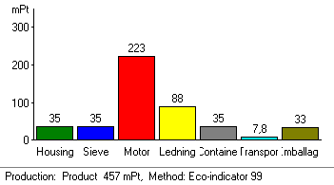
Step 5: Quantify the environmental impacts
FOR INTERNAL USE ONLY!
Results can vary depending on the combination and content of the three factors: model, data and methodology
Results are merely a quick and general estimation
To use quantified environmental figures in connection with external communication a full life cycle assessment (according to ISO standards) must be made and independently approved
However, simplified methods are often both sufficient and the most useful choice for daily product development work
Notes:
FOR INTERNAL USE ONLY!
Be aware that results can vary depending on the combination and content of the three factors: model, data and methodology. And you should not take the result for more than it is – merely a quick and general estimation.
If you wish to use quantified environmental figures in connection with external communication to customers and suppliers (for example, in environmental reporting), you must make full life cycle calculations according to ISO standards and have these reviewed by a third party. Simplified methods are not sufficient for external communication.
However, simplified methods are often both sufficient and the most useful choice for daily product development work – especially after they have been used a few times in the company, to both learn the technique and to tailor the databases and the model.

Slide 5
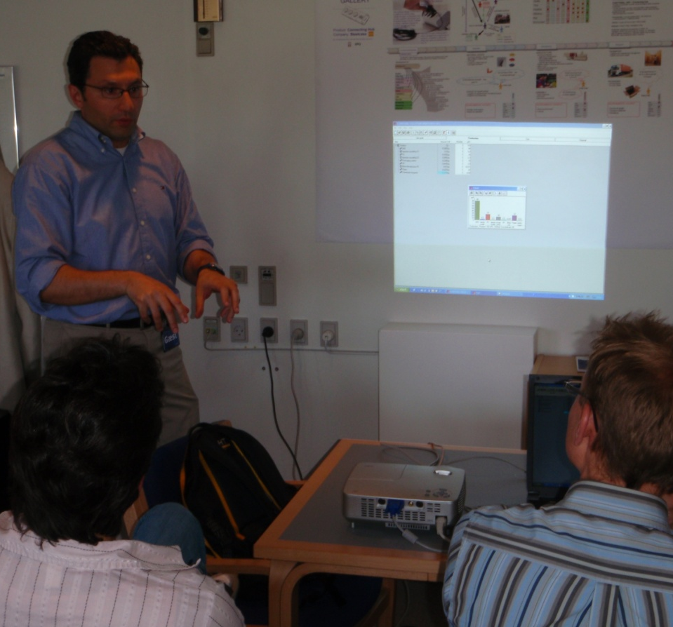
Step 5: Quantify the environmental impacts
STEP-BY-STEP APPROACH
Choose a method for assessing the environmental impacts of your product. Use the results from Step 1 to 4 to describe the product and its life cycle.
Work step-by-step through the method and record underway the different assumptions, you make.
The method typically requires data on product name, functional unit, materials, manufacturing processes, transport, use scenarios and disposal scenarios.
Prepare a presentation of the results from the exercise and then identify five environmental focus areas ('*').
Notes:
STEP-BY-STEP APPROACH
Choose a method for assessing the environmental impacts of your product. Use the results from Step 1 to 4 to describe the product and its life cycle.
Work step-by-step through the method and record underway the different assumptions, you have to make. The method typically requires data on product name, functional unit, materials, manufacturing processes, transport, use scenarios and disposal scenarios.
The exercise is complete when the product's life cycle can be modelled in relation to its environmental impacts, and some environmental focus areas can be identified, which the method has helped to reveal.
Prepare a presentation of the results from the exercise and then identify five environmental focus areas ('*').

Slide 6
Step 5: Quantify the environmental impacts
LCA results are usually complex
Example of an LCA result –
Four product alternatives compared in 5 impact categories

Slide 7
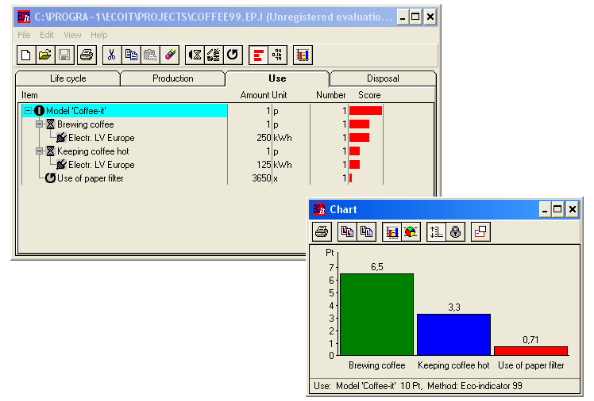

Step 5: Quantify the environmental impacts
Tools for simplified LCAs: e.g. ECO-it
Eco-indicator & ECO-it
[Download fra www.pre.nl]

Slide 8
Step 5: Quantify the environmental impacts
Environmental impact reduced to a single indicator
Eco-indicator & ECO-it
[http://www.pre.nl]

Slide 9
Step 5: Quantify the environmental impacts
Example of using ECO-it
Abridged LCA of a citrus press, using ECO-it

Slide 10
Step 5: Quantify the environmental impacts
Assumptions during the assessment
Materials stage
  What product version is chosen representative?
  Which parts does it consist of? (incl. motor)
  Which types & weights of materials? (gross/net)
Production
  Which processes are involved? (incl. overheads)
Transport stage
  Which distances will be covered?
  With which means of transport?
Use stage
  How often will the citrus press be used (and cleaned)? and where?
End-of-Life/Disposal stage
  What is/are the most likely disposal way/s?

Slide 11
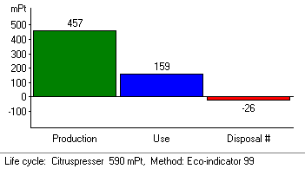
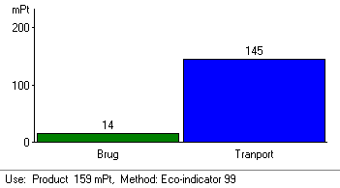
Step 5: Quantify the environmental impacts
Results
ECO-it results in the different life cycle stages

Slide 12
Step 5: Quantify the environmental impacts
Quantify the environmental effects
  Use an abridged LCA tool, such as ECO-it, to model your product’s life cycle
  Choose 5 environmental ‘*’ priorities!

Slide 13
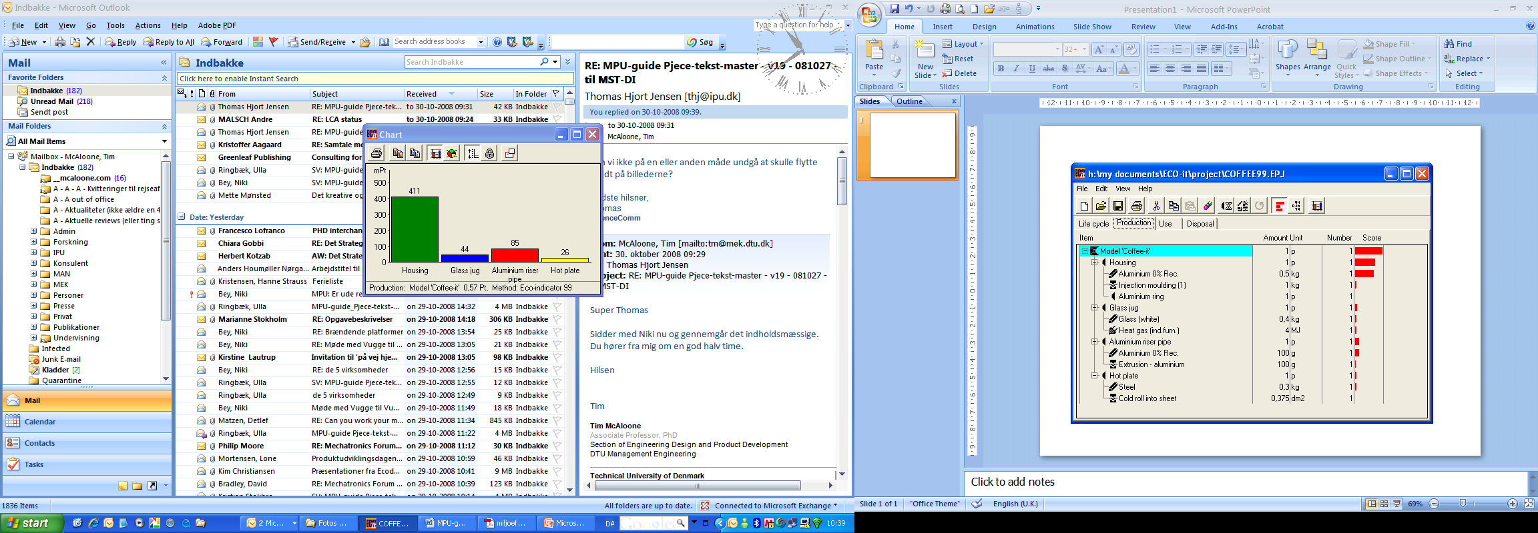
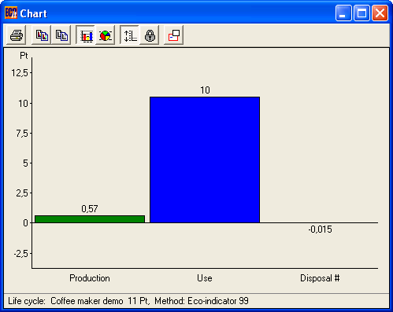
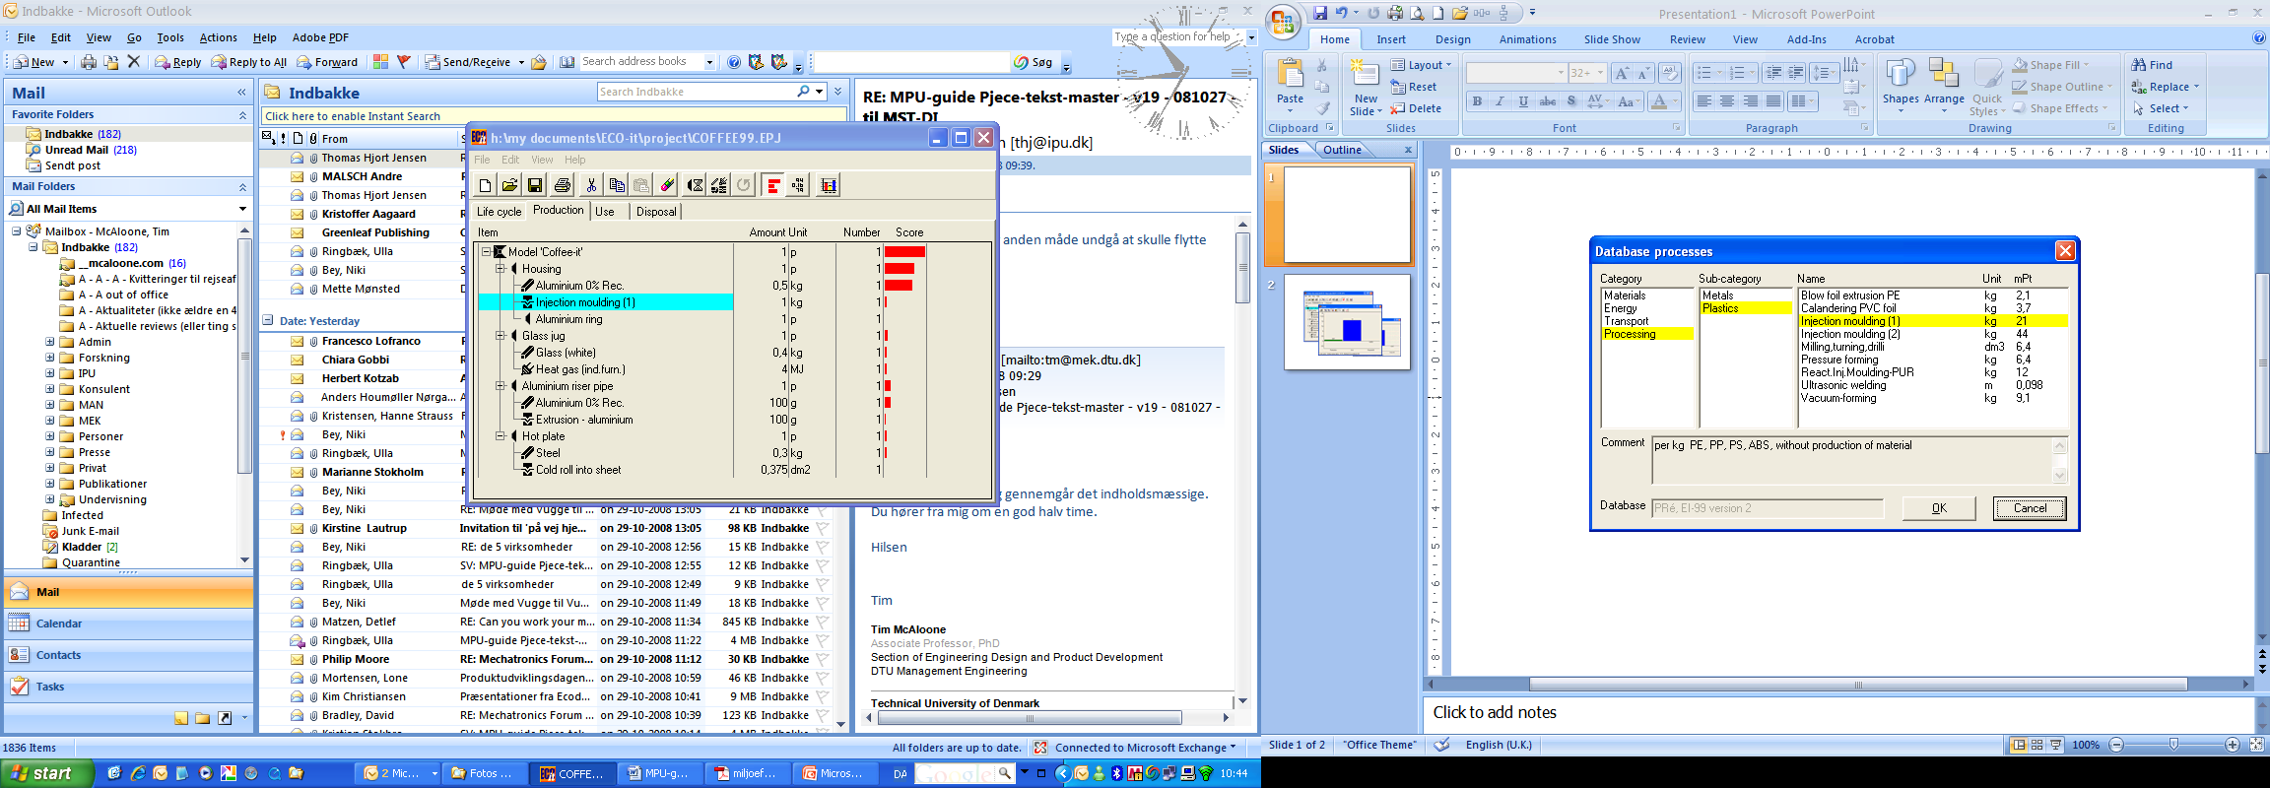
Step 5: Quantify the environmental impacts

Slide 14
Step 5: Quantify the environmental impacts
WHY CARRY OUT THIS EXERCISE?
To provide another entry point to the environmental improvement task, based on highly simplified assessment methods
The limitations of these tools are clear, but even so, these simplified methods give a quick overview of a product's environmental profile
The tools can be used to create scenarios, in order to compare alternative processes, materials etc.
The previous slides show results from the “ECO-it” tool – but there are many other so-called “Abridged LCA” tools available
Notes:
WHY CARRY OUT THIS EXERCISE?
The quantitative environmental exercise provides another entry point to the environmental improvement task, based on highly simplified assessment methods.
The limitations of these tools are clear; many assumptions must be made and the results are only as reliable as the data and model underlying the calculations. But even with these limitations, these simplified methods give a quick overview of a product's environmental profile.
In addition, you can use the tools to create scenarios where, for example, alternative processes or materials are compared.
The figure shows results from the “ECO-it” tool, which in this example shows that the product’s environmental impact in the use stage is 20 times larger than the manufacturing stage, and even higher than in the disposal stage.

Slide 15


For further information
Tim McAloone
DTU Management Engineering
Engineering Design and Product Development
Building 426, Produktionstorvet, DK-2800 Kgs. Lyngby
Denmark
Telephone (+45) 4525 6270
Homepage www.kp.man.dtu.dk/english/research/areas/ecodesign/guide
Email tmca@man.dtu.dk

