Slide 1
Environmental improvement through product development
Introduction

Slide 2
About this material
This approach to environmental product improvement is one of the results of a project funded by the Danish Environmental Protection Agency and conducted in collaboration with the Confederation of Danish Industry (DI), IPU and the Technical University of Denmark (DTU).
The material is primarily aimed at product developers, as a help to building environmental thinking into the product development process - and thus into products.
Authors: Tim McAloone, DTU Management Engineering
Niki Bey, IPU Product Development
Editors: Ulla Ringbæk, Danish Environmental Protection Agency
Bjarne Palstrøm, Confederation of Danish Industry
Kristian Stokbro, Confederation of Danish Industry
Tina Sternest, Confederation of Danish Industry
Case companies: Coloplast A/S
Fritz Hansen A/S
Gabriel A/S
Grundfos Management A/S
LEGO Group A/S

Slide 3
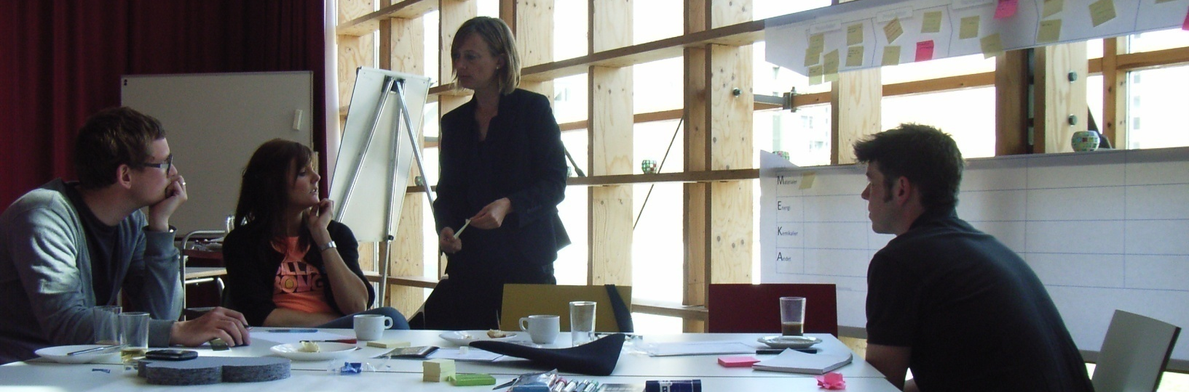
Introduction
Current positive move towards reducing human impacts on the environment and nature
  New business potential
Need to keep a sustained focus on the creation of value for customers and consumers
Companies can contribute to their own agenda, based upon environmentally led innovation
  Requires high involvement of company’s competencies and partners in the value chain.
Notes:
Companies in Denmark and abroad are working increasingly to reduce human impacts on the environment and nature. At the same time there must be a sustained focus on the creation of value for customers and consumers. This development gives rise to a huge potential for companies to create new business opportunities, where sustainable development and value creation are integrated early in the design of new products and services.
There is a great opportunity for businesses to create a new and positive agenda, where the focus is on all the good that companies can do for the environment, society and economic growth. Such an agenda must, of course, be based on a high involvement of the competencies of the companies’ own employees, as well as those of partners in the value chain.

Slide 4
Accepting the environmental challenge
Systematic approaches to environmental impact assessment can lead to competitive advantages for the company
  Processes and relations become transparent
Example:
90% of the waste connected to many of everyday products has been created before the end-user even gets their hands on the products.
Need to create environmentally improved alternatives to existing technologies, materials and procedures
Sustainable development is a collective responsibility for company, customers and suppliers
  There are consequences for all parties
Notes:
Taking a systematic approach to understanding where and why a product has environmental impacts in its lifetime also leads to competitive advantages for the company as processes and relations become transparent.
For instance, around 90% of the waste that can be attributed to many of the products that we meet in our daily lives, has been created before the end-user even gets their hands on the products.
There is therefore a need to create environmentally improved alternatives to existing technologies, materials and procedures.
The company, its customers and its suppliers should all be made aware of the fact, that sustainable development is a collective responsibility, which has consequences for all parties.

Slide 5
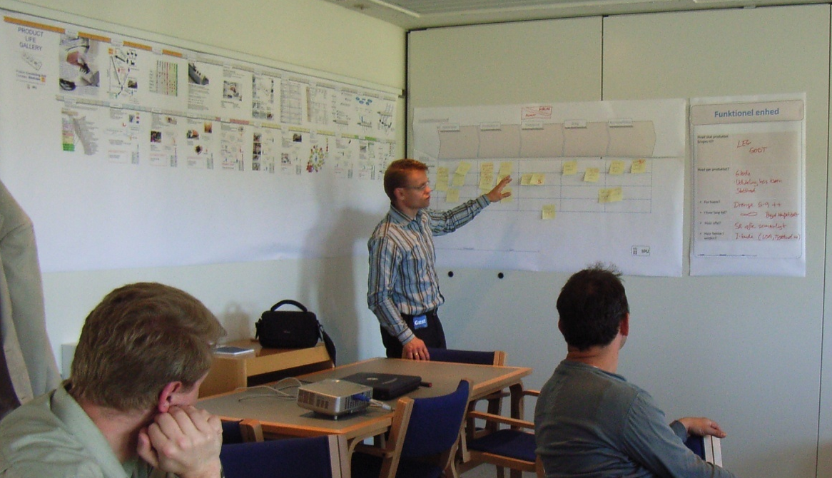
Why think environment into product development?
There are benefits to be reaped from environmental stewardship.
Environmental thinking in product development = efficient products
→ economically viable, cheaper to operate/maintain and more robust over their lifetimes
Environmental thinking in product development = conformance with legislation and standards
  Increasing customer demand here
Environmental product improve-ments = increased product quality
  If done properly!
Notes:
There are benefits to be reaped from environmental stewardship.
It has been demonstrated, for instance, that environmental thinking in product development leads to efficient products, which are both economically viable to produce, cheaper to operate and maintain, and more robust over their lifetimes.
By taking a systematic approach to the environmental design task, environmental product improve-ments can often be equated to increased product quality.

Slide 6
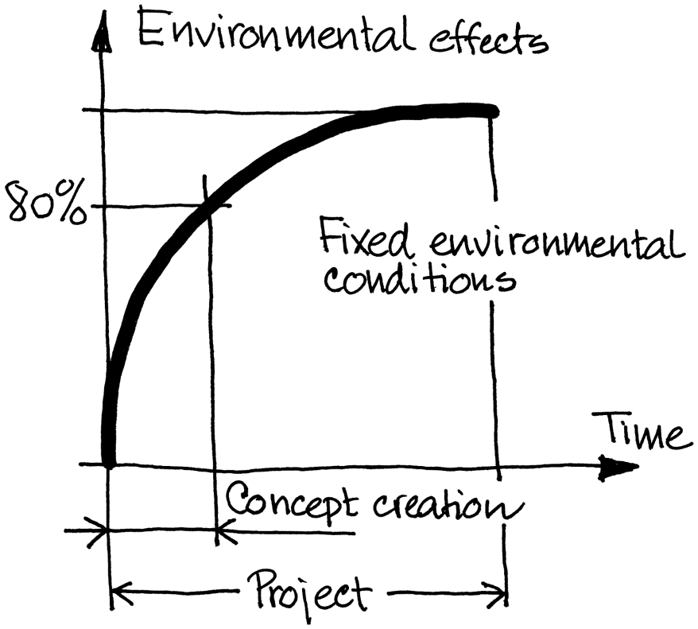
The product developer has the greatest challenge
Environmental impacts caused in all stages of a product's life
Different products = different types of environmental profile
Approx. 80% of a product's environmental profile is fixed under concept creation in product development
Great responsibility for product developer
Approx. 80% of a product's environmental profile is fixed under concept creation in product development
Notes:
Environmental impacts are caused in all stages of a product's life, and different products give rise to different types of environmental profiles.
But regardless of the nature, size and time of occurrence of environmental impacts for a product, the vast majority of these have been decided in the early phases of product development.
Approx. 80% of a product's environmental profile is fixed under concept creation in product development
The product developer has therefore a great influence on the product’s life cycle and also on the subsequently occurring environmental impacts.

Slide 7
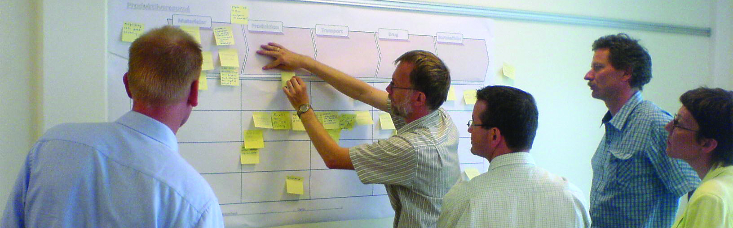
Revealing the product’s life cycle
Systematic environmental improvement is dependent on deep insight into the product's life cycle
Create pictures of the whole life cycle for the product, to ensure that each stage is considered
This activity is called product life thinking.
Product life thinking is a systematic charting of every product life stage, together with the various stakeholders and situations that the product is likely to meet during its lifetime.
It is important to visualise the product's life cycle
Notes:
Good and systematic environmental improvement can only be created on the basis of a solid and deep insight into the product's life cycle.
By forming a picture of the whole life cycle for the product, we can ensure that each stage in the product’s life becomes as environmentally benign as possible.
This activity is called product life thinking.
Product life thinking involves an active and systematic charting of every product life stage, together with the various stakeholders and situations that the product is likely to meet during its lifetime. This broad approach to product development gives the company important insight into life cycle stages such as the product’s use stage, early on in the project.
It is important to visualise the product's life cycle, based on a conception of the various situations and stakeholders that the product will meet throughout its lifetime.
Each product life stage ought to describe both the product and all related activities, in order to create a picture of resource consumption and the root causes of environmental impacts.

Slide 8
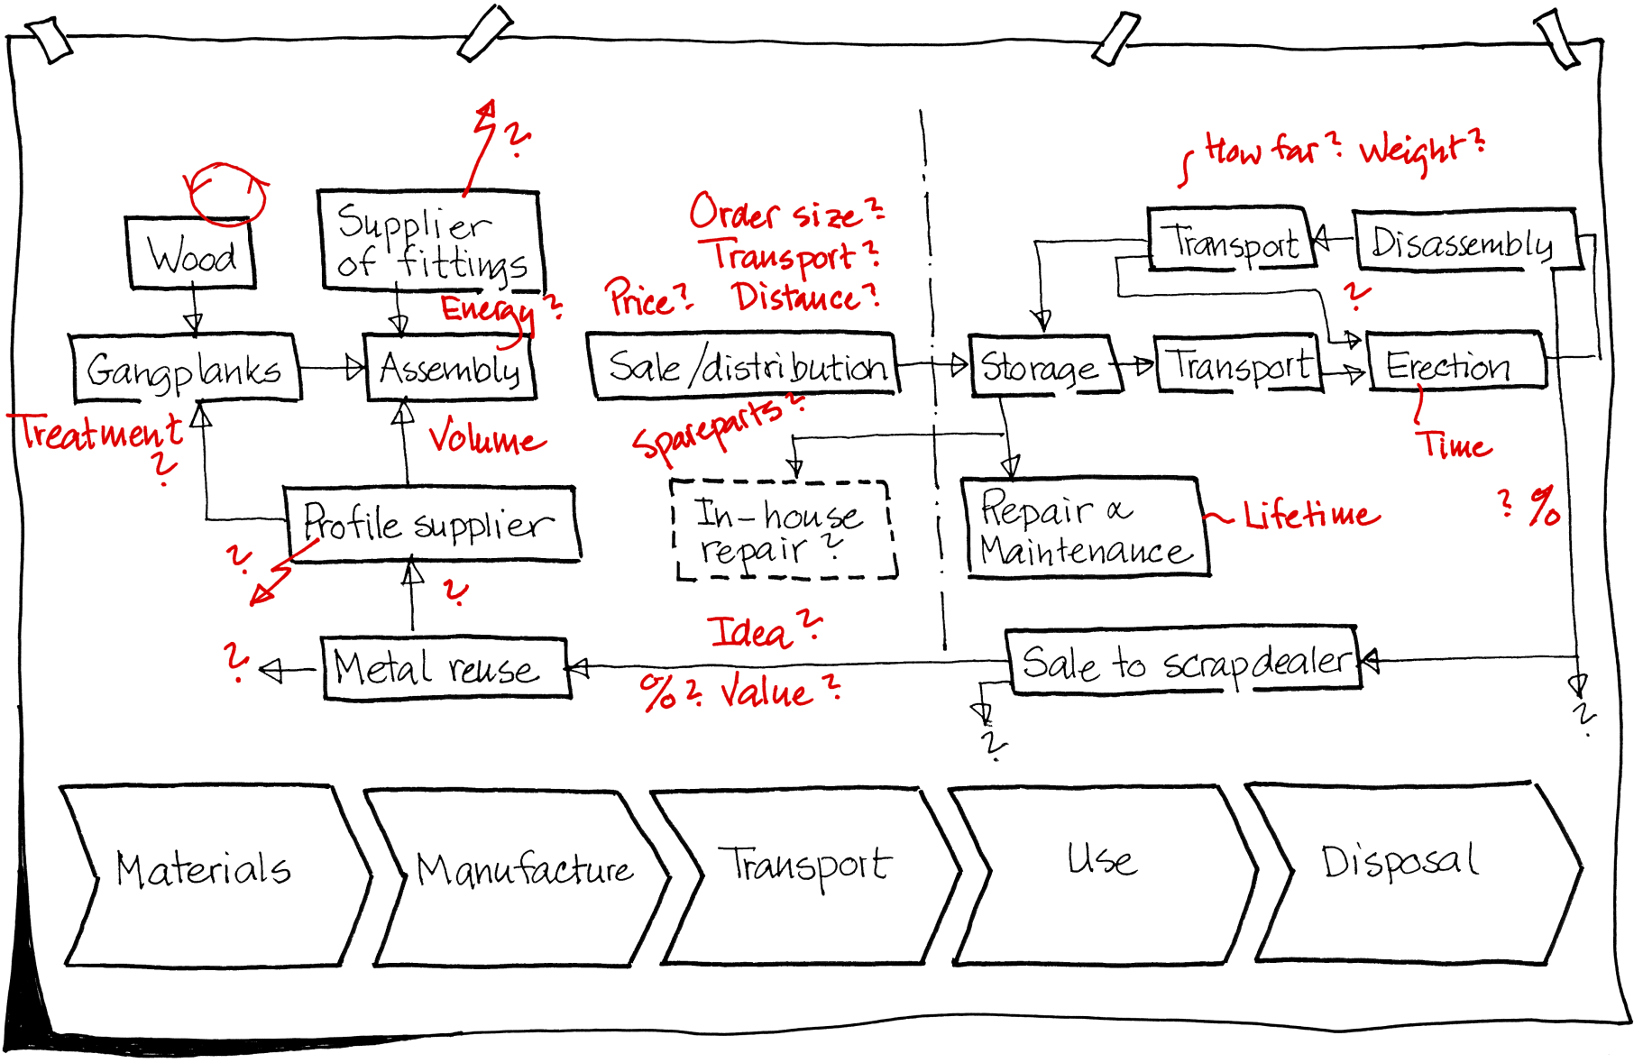
Revealing the product’s life cycle
Example: Mapping the product life cycle for a scaffold. Potential environmental causes are indicated in red.

Slide 9
Environmental improvements in 7 steps
WHY A 7-STEP APPROACH?
There is a need to focus on both environmental analysis and on the creation of new environmental solutions
This Guide leads you through a 7-step, solution-oriented process, towards environmental improvement
The 7 steps are simple, inspiring and different from your ordinary product development tasks
  The approach creates space for innovation by focusing solely on environmental issues
Notes:
Many companies that have had environment on the agenda for some years will righteously be able to claim that they have a good grip on the more eco-analytical tasks and on environmental documentation and reporting. But in contrast, there is often far less focus on the creation of completely new environmental solutions.
The method developed for this approach to environmental improvement in product development will lead you through a 7-step, solution-oriented process, towards environmental improvement.
The 7 steps are simple, inspiring and different from your ordinary product development tasks. The approach creates space for innovation by focusing solely on environmental issues.

Slide 10
Environmental improvements in 7 steps
GET A GRIP ON THE ENVIRONMENT
The following 7-step approach is built up to aid you to:
  get an overview of your product's environmental effects
  provide insight into important details concerning the product’s environmental impacts, its use and its users
  create solutions and concepts that lead to environmental improvements, and
  create foresighted proposals for the creation of an environmental strategy for product development

Slide 11
Environmental improvements in 7 steps
THE METHOD BEHIND THE 7-STEP APPROACH
Designed as a sequential chain of exercises
A product must be chosen in advance, as the object for environmental improvement
  Can be either an already marketed product, which will serve as a reference product, or a product that is currently under development
First 6 steps of the 7-step approach isolate the environmental task and focus on identifying environmental effects
  Subsequently improvement proposals are created
  Step 7 provides a framework for an action plan
* Try in each step to define five key environmental priorities that later can be used to begin a final prioritisation! Mark these priorities with a red ‘*’
Notes:
The 7-step approach is designed as a chain of exercises that ought to be completed from start to finish. It is important, for example, that the product’s life cycle and environmental impacts are charted, before commencing with the creation of solutions.
The approach requires that a product is chosen in advance, as the object for environmental improvement. The product can be either an already marketed product, which will serve as a reference product, or a product that is currently under development. The first case is the easiest, as it is easier to identify data about the product’s life cycle.
The first 6 steps of the 7-step approach isolate the environmental task and focus on identifying environmental effects. Subsequently improvement proposals are created. Step 7 provides a framework for an action plan and the basis for systematic integration of the proposed environ-mental improvements into the product development process.
* Try in each step to define five key environmental priorities that later can be used to begin a final prioritisation! Mark these priorities with a red ‘*’

Slide 12
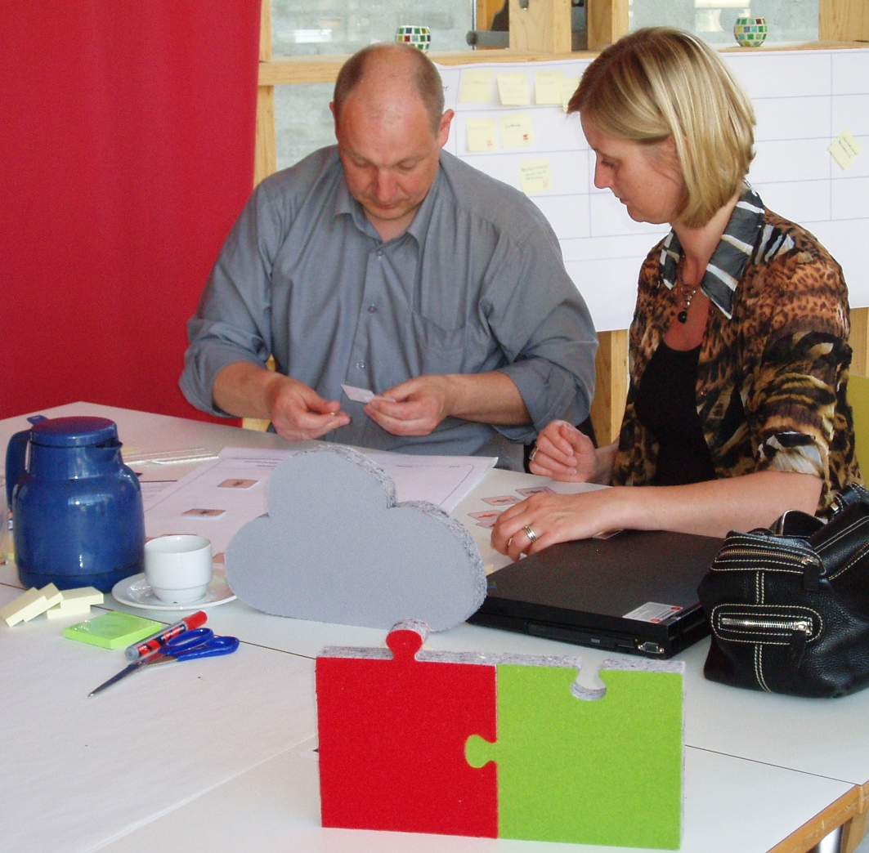
Environmental improvements in 7 steps
WHO SHOULD PARTICIPATE?
All the staff who play an active role in the areas of the company, which may be linked to the product’s environmental impacts.
Participants representing a wide range of disciplines, e.g.
  mechanical engineers
  environmental specialists
  industrial designers
  materials specialists
  factory manager
  etc.
Active participation from the delegates is a must!
Notes:
The target audience for this approach is all the staff who play an active role in the areas of the company, which may be linked to the product’s environmental impacts.
It is best if the participants represent a wide range of disciplines, from mechanical engineers, through environmental specialists, industrial designers and materials specialists, to the factory manager.

Slide 13
Environmental improvements in 7 steps
PREPARATION FOR THE APPROACH
Executed as a physical workshop, lasting at least one working day
Reserve sufficient time for preparation and follow-up work
Reporting is carried out as a part of the process
Environmental improvements are created as the principal outcome
The following considerations will contribute to a successful workshop:
  Prepare each step carefully beforehand, so the methodology and the necessary practical preparations are ensured.
  Participants should prepare themselves by collecting as much knowledge about the product as possible.
  A coordinator must be identified (either the company’s own environmental champion or an external consultant). The coordinator organises and facilitates the process, as well as motivating the participants to come prepared for meetings.
  At least two examples of the reference product should be provided; one assembled and one disassembled (if the product is suited for this).
  Prepare a working space so as to enable and encourage group discussions – and with plenty of wall space for posters.
  A series of posters should be prepared, to facilitate the process and ensure reporting.
  Create groups of up to 7 people. If there are more than 7 people, then create more groups, which can compete against each other for the good ideas!
Notes:
The approach is executed as a physical meeting, lasting at least one working day. In addition, one should reserve sufficient time for preparation and follow-up work. Active participation from the delegates is a must. Reporting is carried out as a part of the process and environmental improvements are created as the principal outcome.
The following considerations will contribute to a successful workshop:
Prepare each step carefully beforehand, so the methodology and the necessary practical preparations are ensured.
Participants should prepare themselves by collecting as much knowledge about the product as possible.
A coordinator must be identified (either the company’s own environmental champion or an external consultant). The coordinator organises and facilitates the process, as well as motivating the participants to come prepared for meetings.
At least two examples of the reference product should be provided; one assembled and one disassembled (if the product is suited for this).
Prepare a working space so as to enable and encourage group discussions – and with plenty of wall space for posters.
A series of posters should be prepared, to facilitate the process and ensure reporting.
Create groups of up to 7 people. If there are more than 7 people, then create more groups, which can compete against each other for the good ideas!

Slide 14
Environmental improvements in 7 steps
Step 1
Use context
How is the product used? By whom? For how long? The central issue here is to uncover the environmental impacts related to the product’s functionality for the user.
Step 2
Overview
We expand our view to the life cycle. How is the product manufactured, distributed, and disposed of? Which environmental impacts does this lead to?
Step 3
Eco-profile
The environmental impacts shall be split into four categories so they can be compared. What are the origins of the environmental impacts?
Step 4
Stakeholder-
network
Draw a network of all stakeholders who come into contact with the product. Plot the connections between these, and identify environmental impacts.
Step 5
Put figures on the product’s environmental impacts. Create scenarios for alternative processes, materials and life cycles. Consider the likelihood of the scenarios.
Quantification
Step 6
Try to remove or reduce the environmental impacts by creating solutions towards product- or life cycle changes.
Use the ecodesign principles provided and sketch eco-concepts.
Conceptualisation
Steps 1-6 are an innovative, environmental-oriented experiment. Extract your experiences from these steps and make a generalised plan for your company’s environmental strategy:
Step 7
Make an action plan for the environmental efforts for your company, especially for product development.
Eco-strategy

Slide 15


For further information
Tim McAloone
DTU Management Engineering
Engineering Design and Product Development
Building 426, Produktionstorvet, DK-2800 Kgs. Lyngby
Denmark
Telephone (+45) 4525 6270
Homepage www.kp.man.dtu.dk/english/research/areas/ecodesign/guide
Email tmca@man.dtu.dk

